Slide 1






Credit Card Fraud Detection with ML
Detecting fraudulent transactions using supervised machine learning

Slide 2


CONTENTS
01
02
03
04
Problem & Data
Data Insights
Model Results
Model Validation
05
06
07
08
Threshold Optimization​
Conclusion
Enhancements
Interpretability

Slide 3

01
Problem & Data

Slide 4

Motivation for Real-Time Fraud Detection
Credit card fraud causes billions in losses globally.
Traditional rule-based systems miss sophisticated fraud schemes
Fraud must be detected before a transaction is approved.
False negatives are extremely costly.
Banking systems rely on calibrated probability estimates for millisecond decisions.

Slide 5
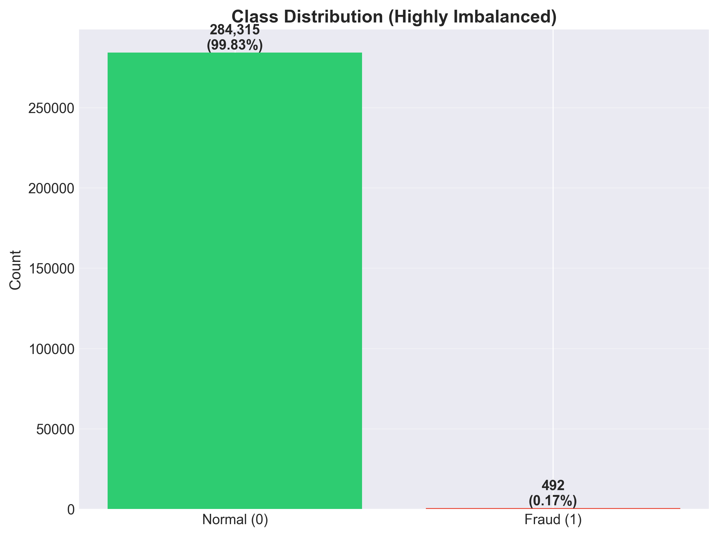
Dataset Overview & Task
284,807 transactions from European cardholders (2013).
Only 492 fraud cases (0.17%).
28 PCA features (V1–V28) + Amount + Time.
Labels: 1 = fraud, 0 = legitimate.
Task: Supervised binary classification.

Slide 6
Proposal Summary & Extensions
Original Plan
Models: Logistic Regression, Random Forest, XGBoost
Techniques: SMOTE, scaling, cross-validation
Goal: Compare ML models for fraud detection
Our final pipeline is significantly richer than the original proposal.

Slide 7
Final Pipeline
1. Advanced Data Understanding​
t-SNE Clustering​
IsolationForest Anomaly Score Distribution​
PCA Variance Analysis​
Fraud vs Normal Distribution Comparison
2. Robust Preprocessing
Selective Outlier Removal (Fraud class only)
Anomaly Feature Engineering via IsolationForest (added 31st feature)
3. Model Development
13 models trained, including:
Baselines (LR, RF, XGB)
Class-weight variants
scale_pos_weight for XGB
LightGBM (added beyond proposal)
Bagging, EasyEnsemble
Voting ensemble
4. Model Results
PR-AUC
Precision
Recall
F2 Score
F1 Score
5. Model Validation
5-Fold Stratified CV for 4 models
Hold-out vs CV stability analysis
6. Threshold Optimization
F2 Optimization
Youden’s J Statistic
Cost-sensitive threshold tuning
Business scenario: FN/FP = 50–500
7. Probability Calibration (Banking Requirement)
Isotonic and Sigmoid calibration for XGB, RF, LGBM
Brier score comparison
8. Interpretability (SHAP)
Global SHAP (31 features)
Fraud-only SHAP
SHAP interaction analysis

Slide 8
02
Data Insights

Slide 9
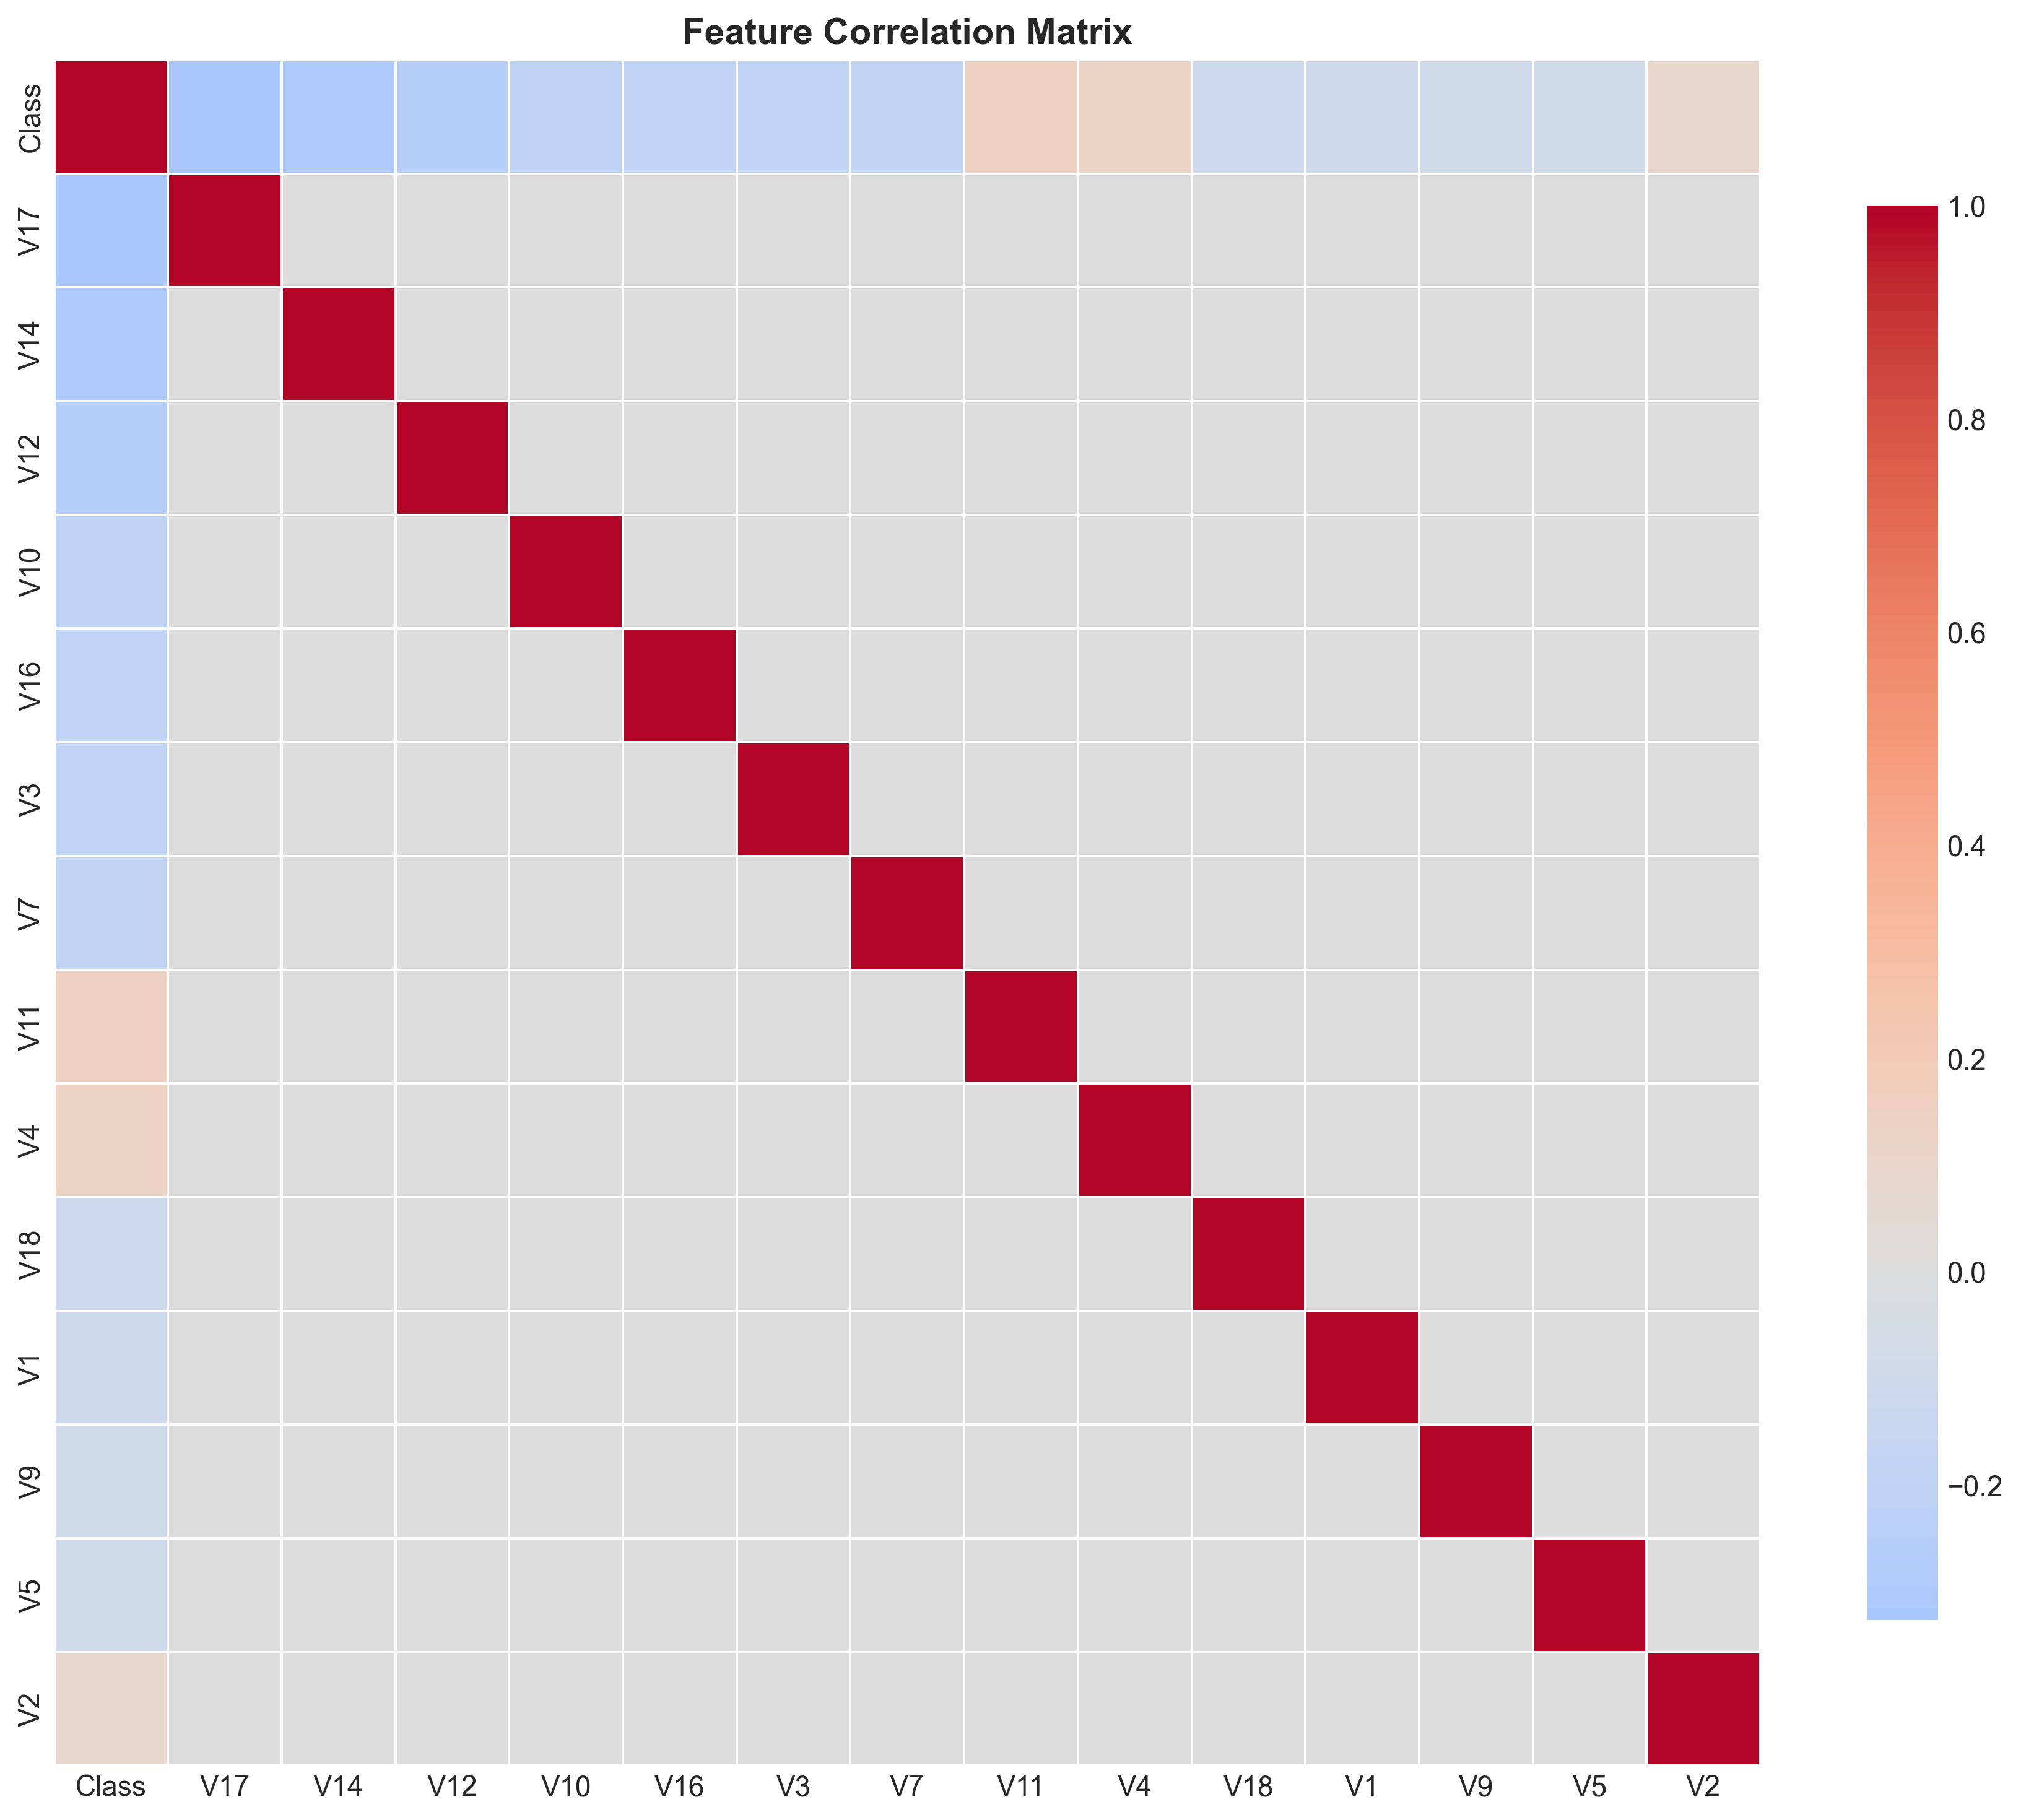
PCA Structure & Scaling
PCA encodes complex covariance structure that are sensitive to scaling and sampling.
First 22 components explain ~95% variance.
This explains why many standard imbalance techniques failed.

Slide 10
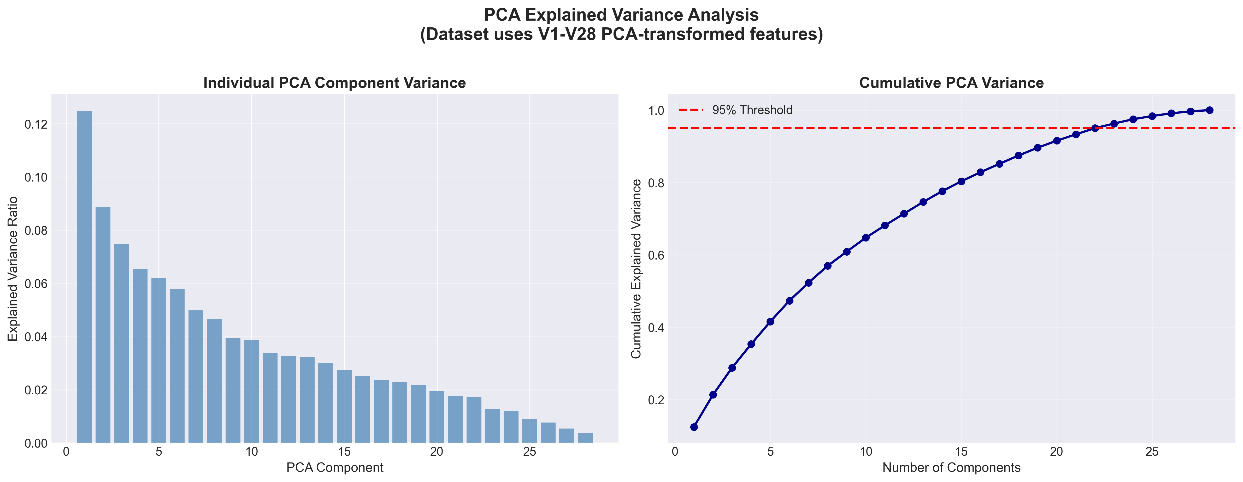

Slide 11
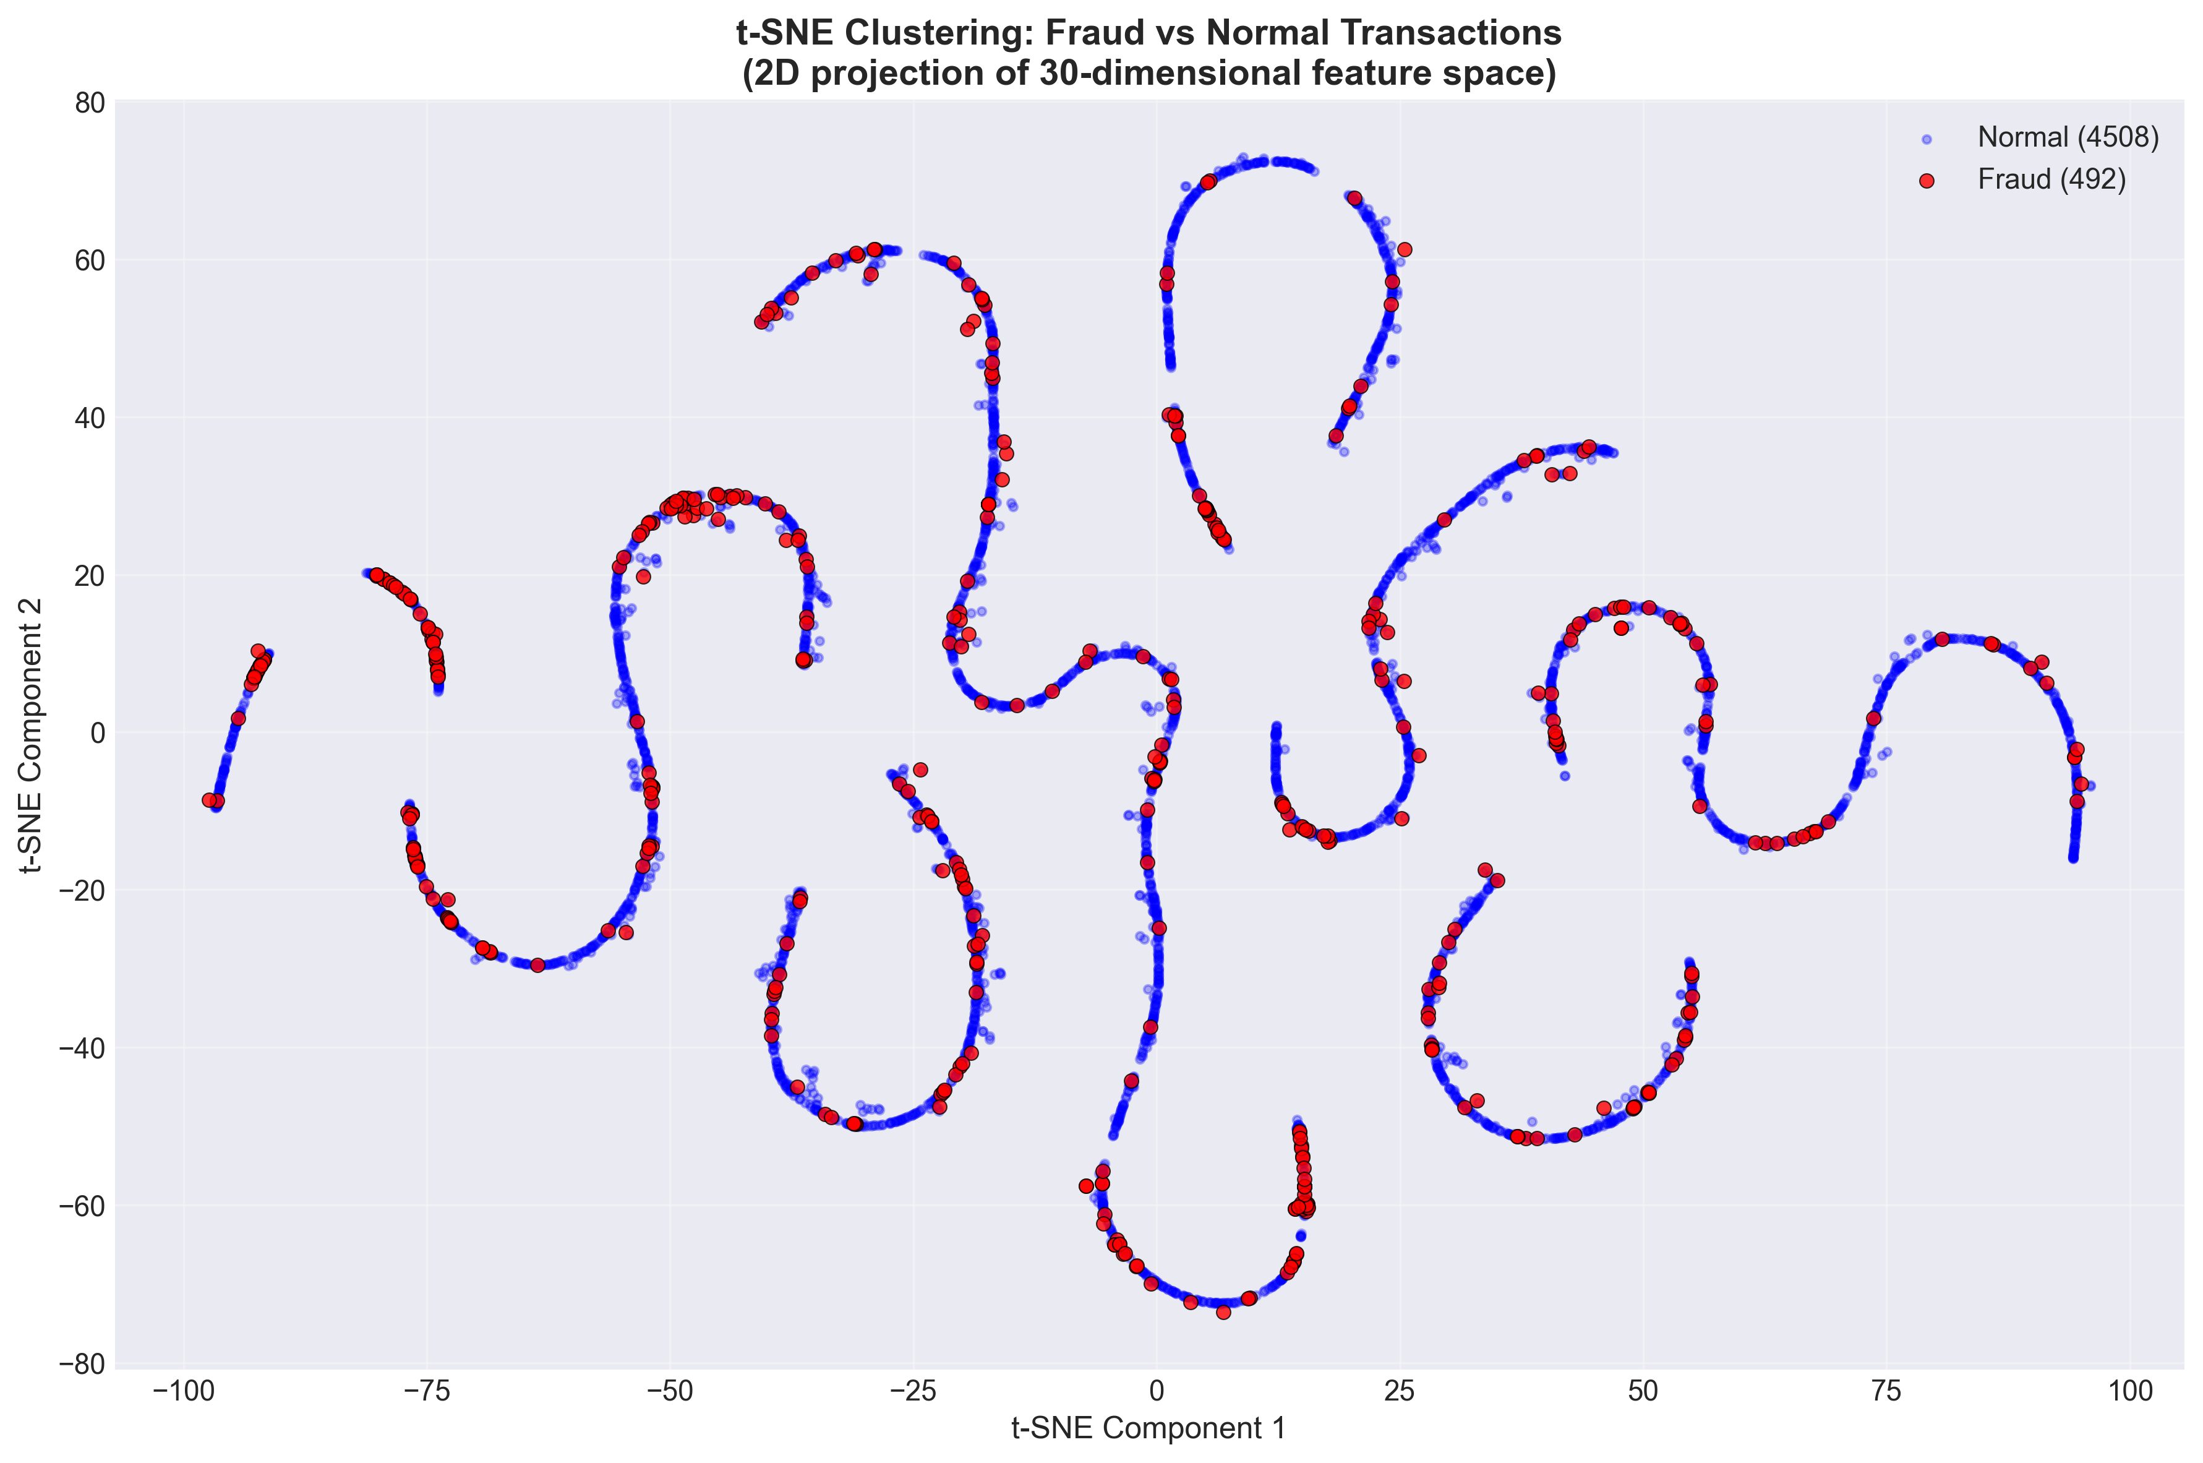
t-SNE Reveals Fraud Clusters
Fraud Transactions
Form compact, dense anomaly clusters.
Legitimate Transactions
Spread widely across a larger manifold.
This visual motivates using an IsolationForest anomaly score.

Slide 12
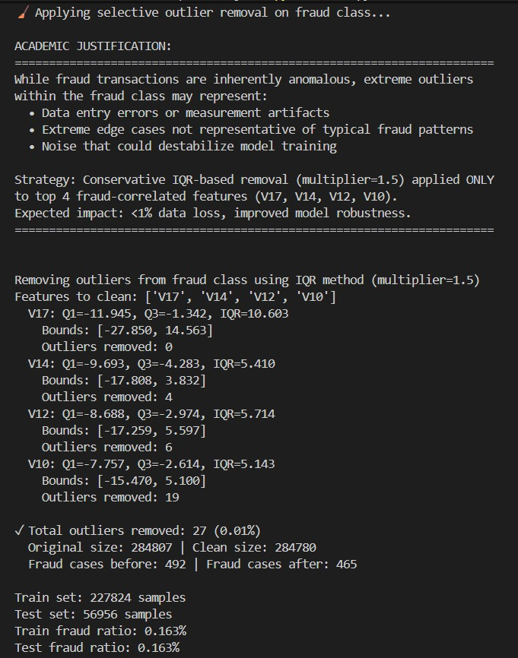
Conservative Outlier Filtering
Total outliers removed: 27 (0.01%)
Original size: 284807
Clean size: 284780
Fraud cases before: 492
Fraud cases after: 465
<1% conservative outlier removal in V10, V12, V14, V17 to remove noise, not fraud.

Slide 13
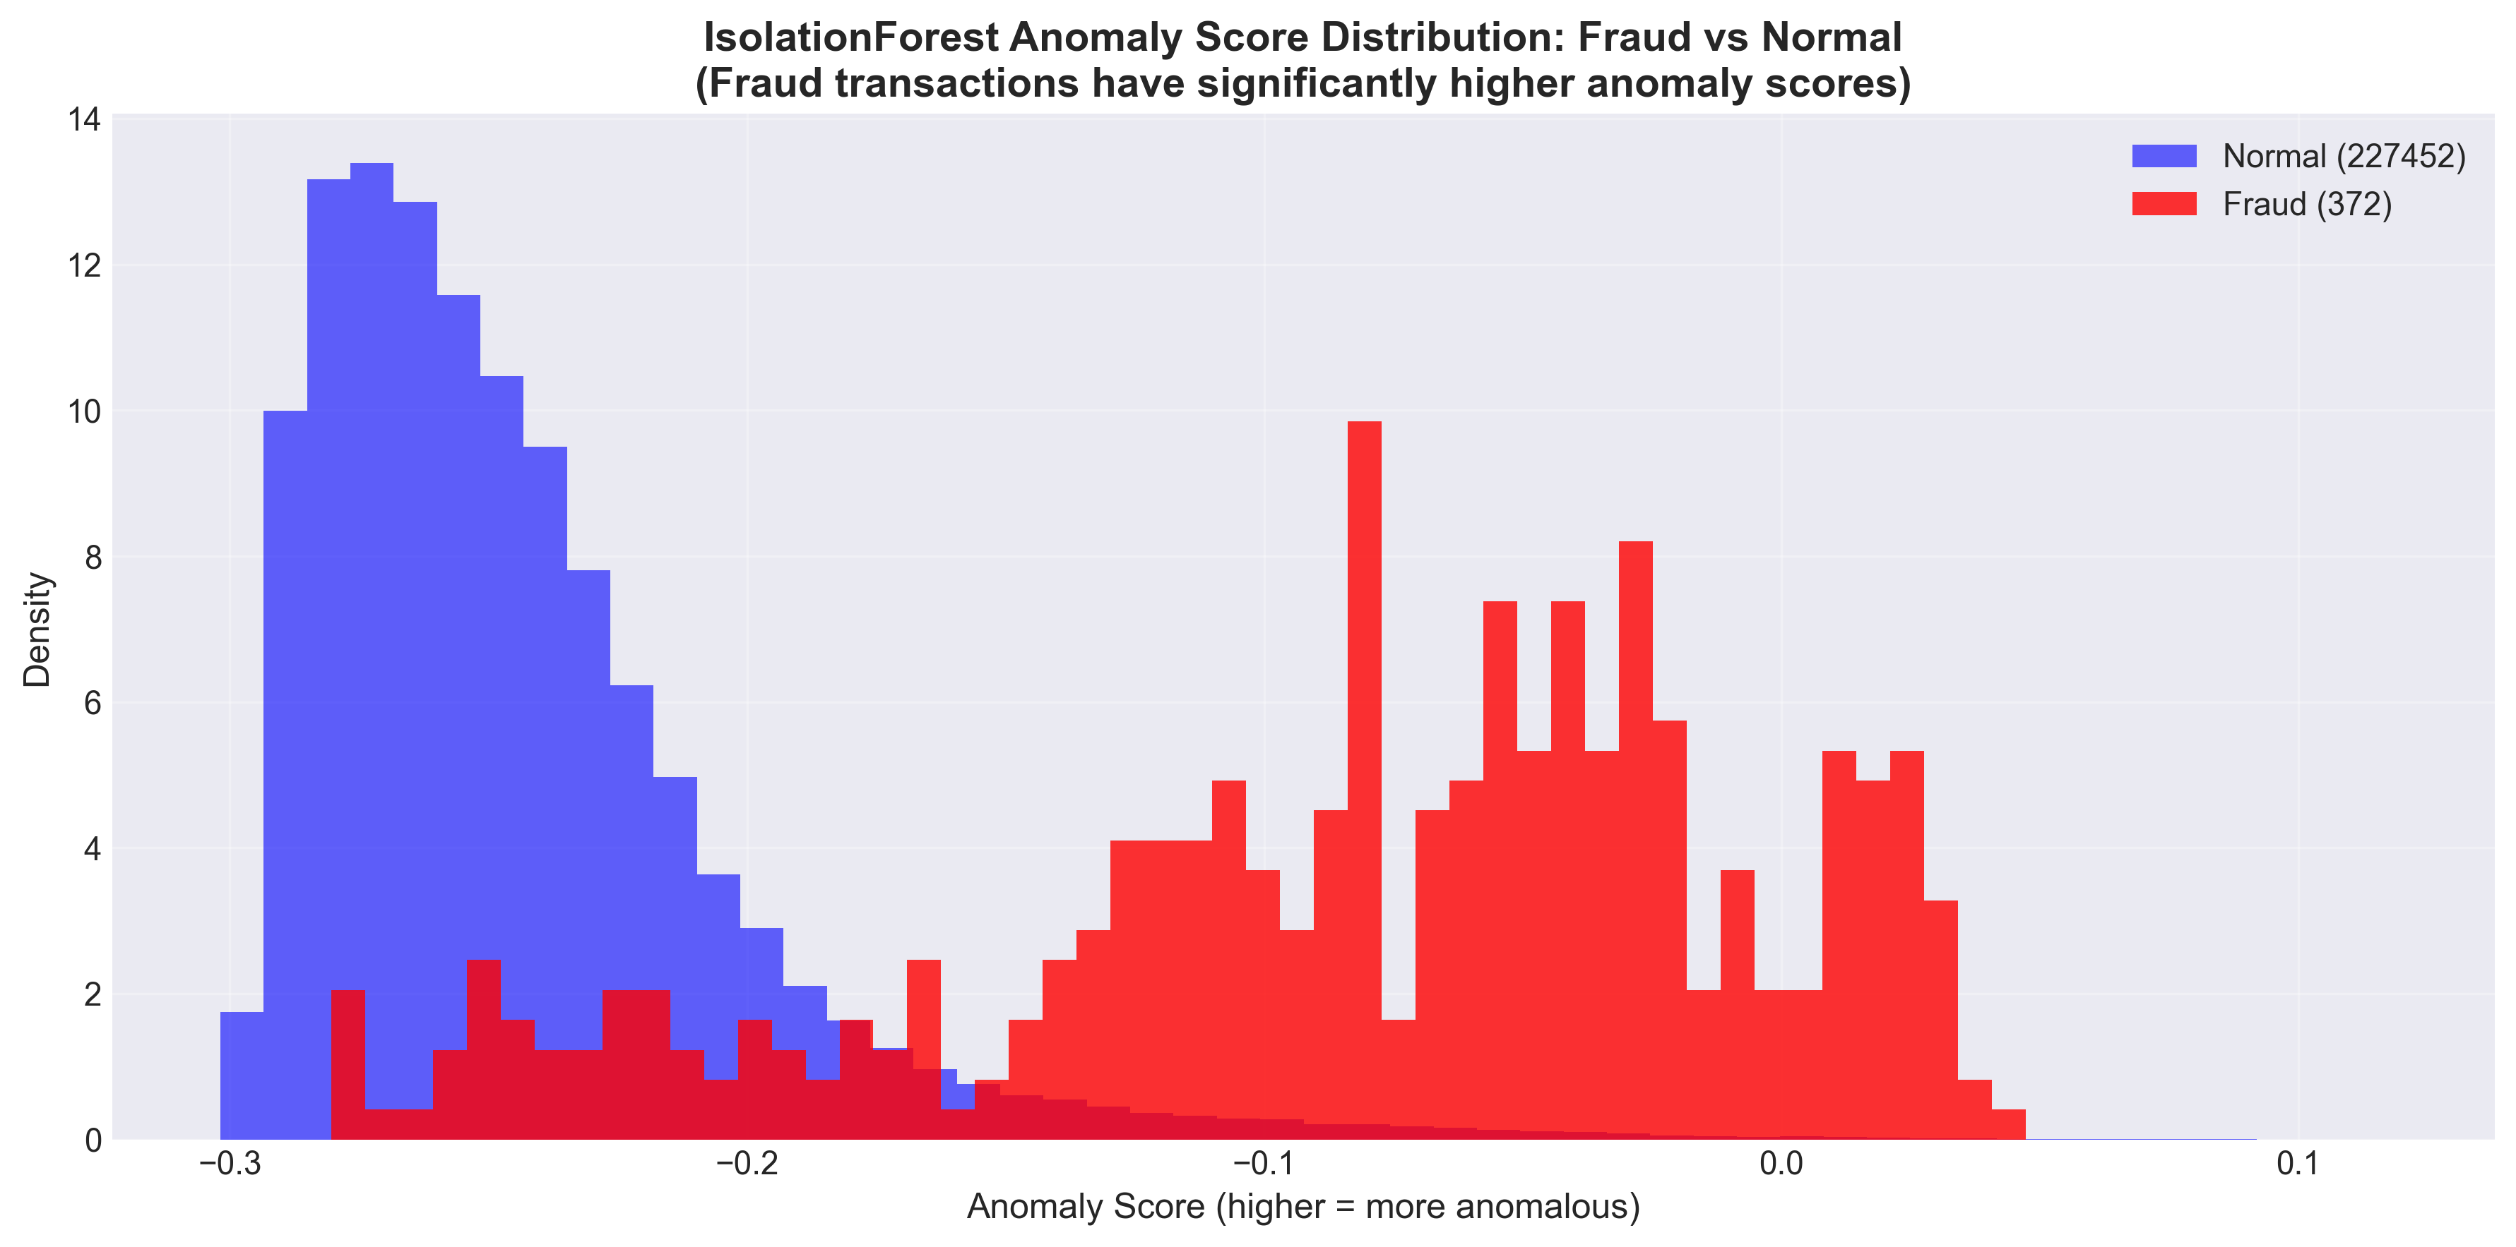

Slide 14
SMOTE Attempt & Rejection
SMOTE was applied as promised in the proposal to fulfill the initial plan.
PCA features made synthetic SMOTE points distort geometry.
Result: PR-AUC decreased, so SMOTE was removed.

Slide 15
03
Model Results

Slide 16
Models Trained in the Pipeline
Logistic Regression (scaled)
Random Forest
XGBoost (scale_pos_weight)
LightGBM (class weights)
BalancedBagging
EasyEnsemble
Voting Ensemble
Calibration
Threshold Optimization

Slide 17
Why PR-AUC is the Right Metric?
Metric | Verdict | Technical Rationale (The "Why")
Accuracy | ❌ Misleading | Accuracy is misleading in fraud detection.It is dominated by normal transactions and hides how well fraud is actually detected.
ROC-AUC | ⚠️ Over-Optimistic | ROC-AUC often looks strong, but it is over-optimistic in highly imbalanced datasets.
PR-AUC | 🏆 Model Selection Metric | PR-AUC measures the model’s ability to rank fraudulent transactions ahead of normal ones. Unlike F1 or F2, it evaluates performance across all thresholds. This makes PR-AUC threshold-independent and reliable under extreme class imbalance.
Recall | 🛡️ Coverage | Recall measures how many fraud cases we actually catch.
Precision | 🎯 Reliability | Precision measures how many predicted frauds are actually fraud.
F1-Score | ⚖️ Balanced Metric | F1-score balances precision and recall equally.
F2-Score | 🚀 Optimization Target | F2-score gives more importance to recall than precision but it does not guarantee higher recall — it simply optimizes the recall–precision trade-off at a single threshold.

Slide 18
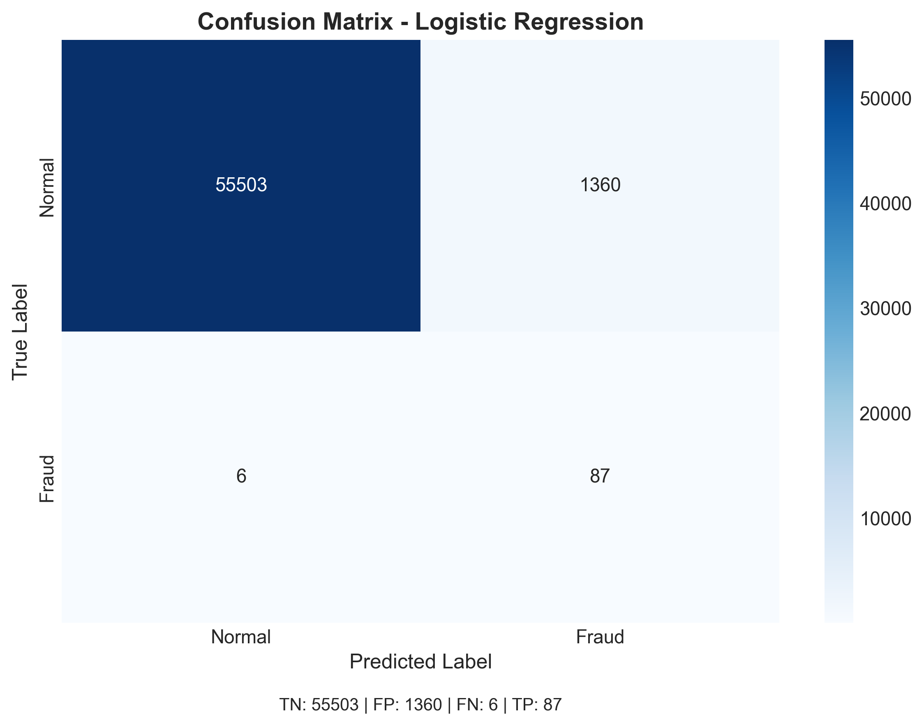
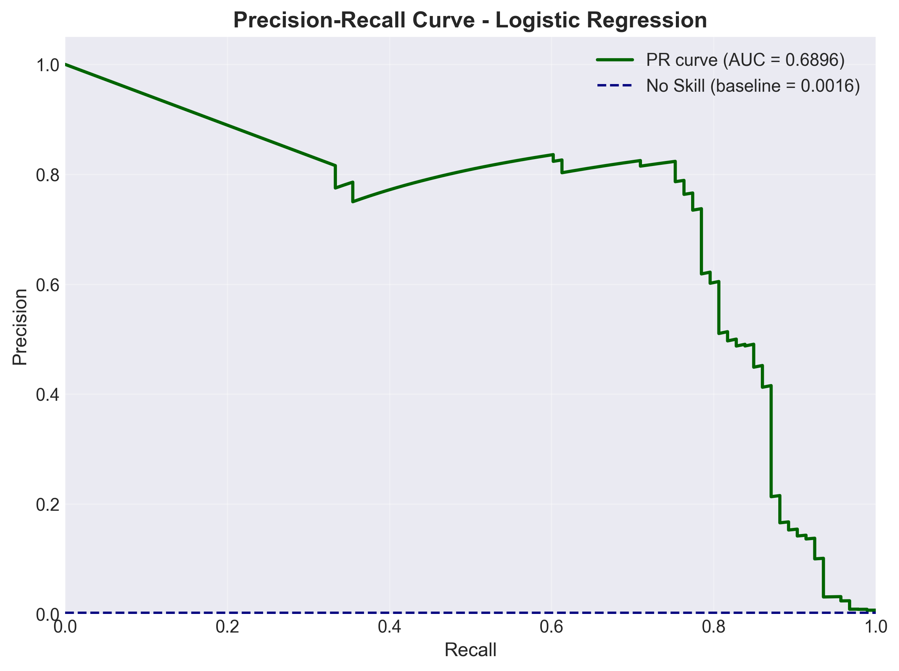
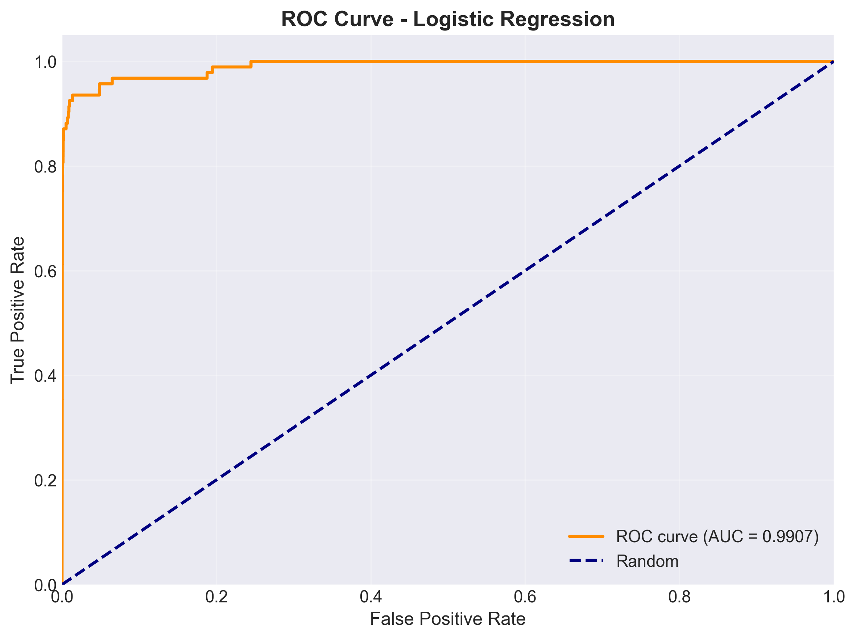
Logistic Regression Results (class_weights)
Purpose: Baseline model (proposal requirement)
Impact: Thousands of false alarms → not deployable
High Recall (0.93), Low Precision (0.06)
PR-AUC: ~0.69 (weak)
When we applied class weights, the Recall increased significantly to 94% , However, this caused a drop in Precision due to the 'Precision-Recall Trade-off.
The model became more aggressive in catching frauds.
Since Logistic Regression is a linear model, it struggled to separate the classes perfectly without creating false alarms.

Slide 19
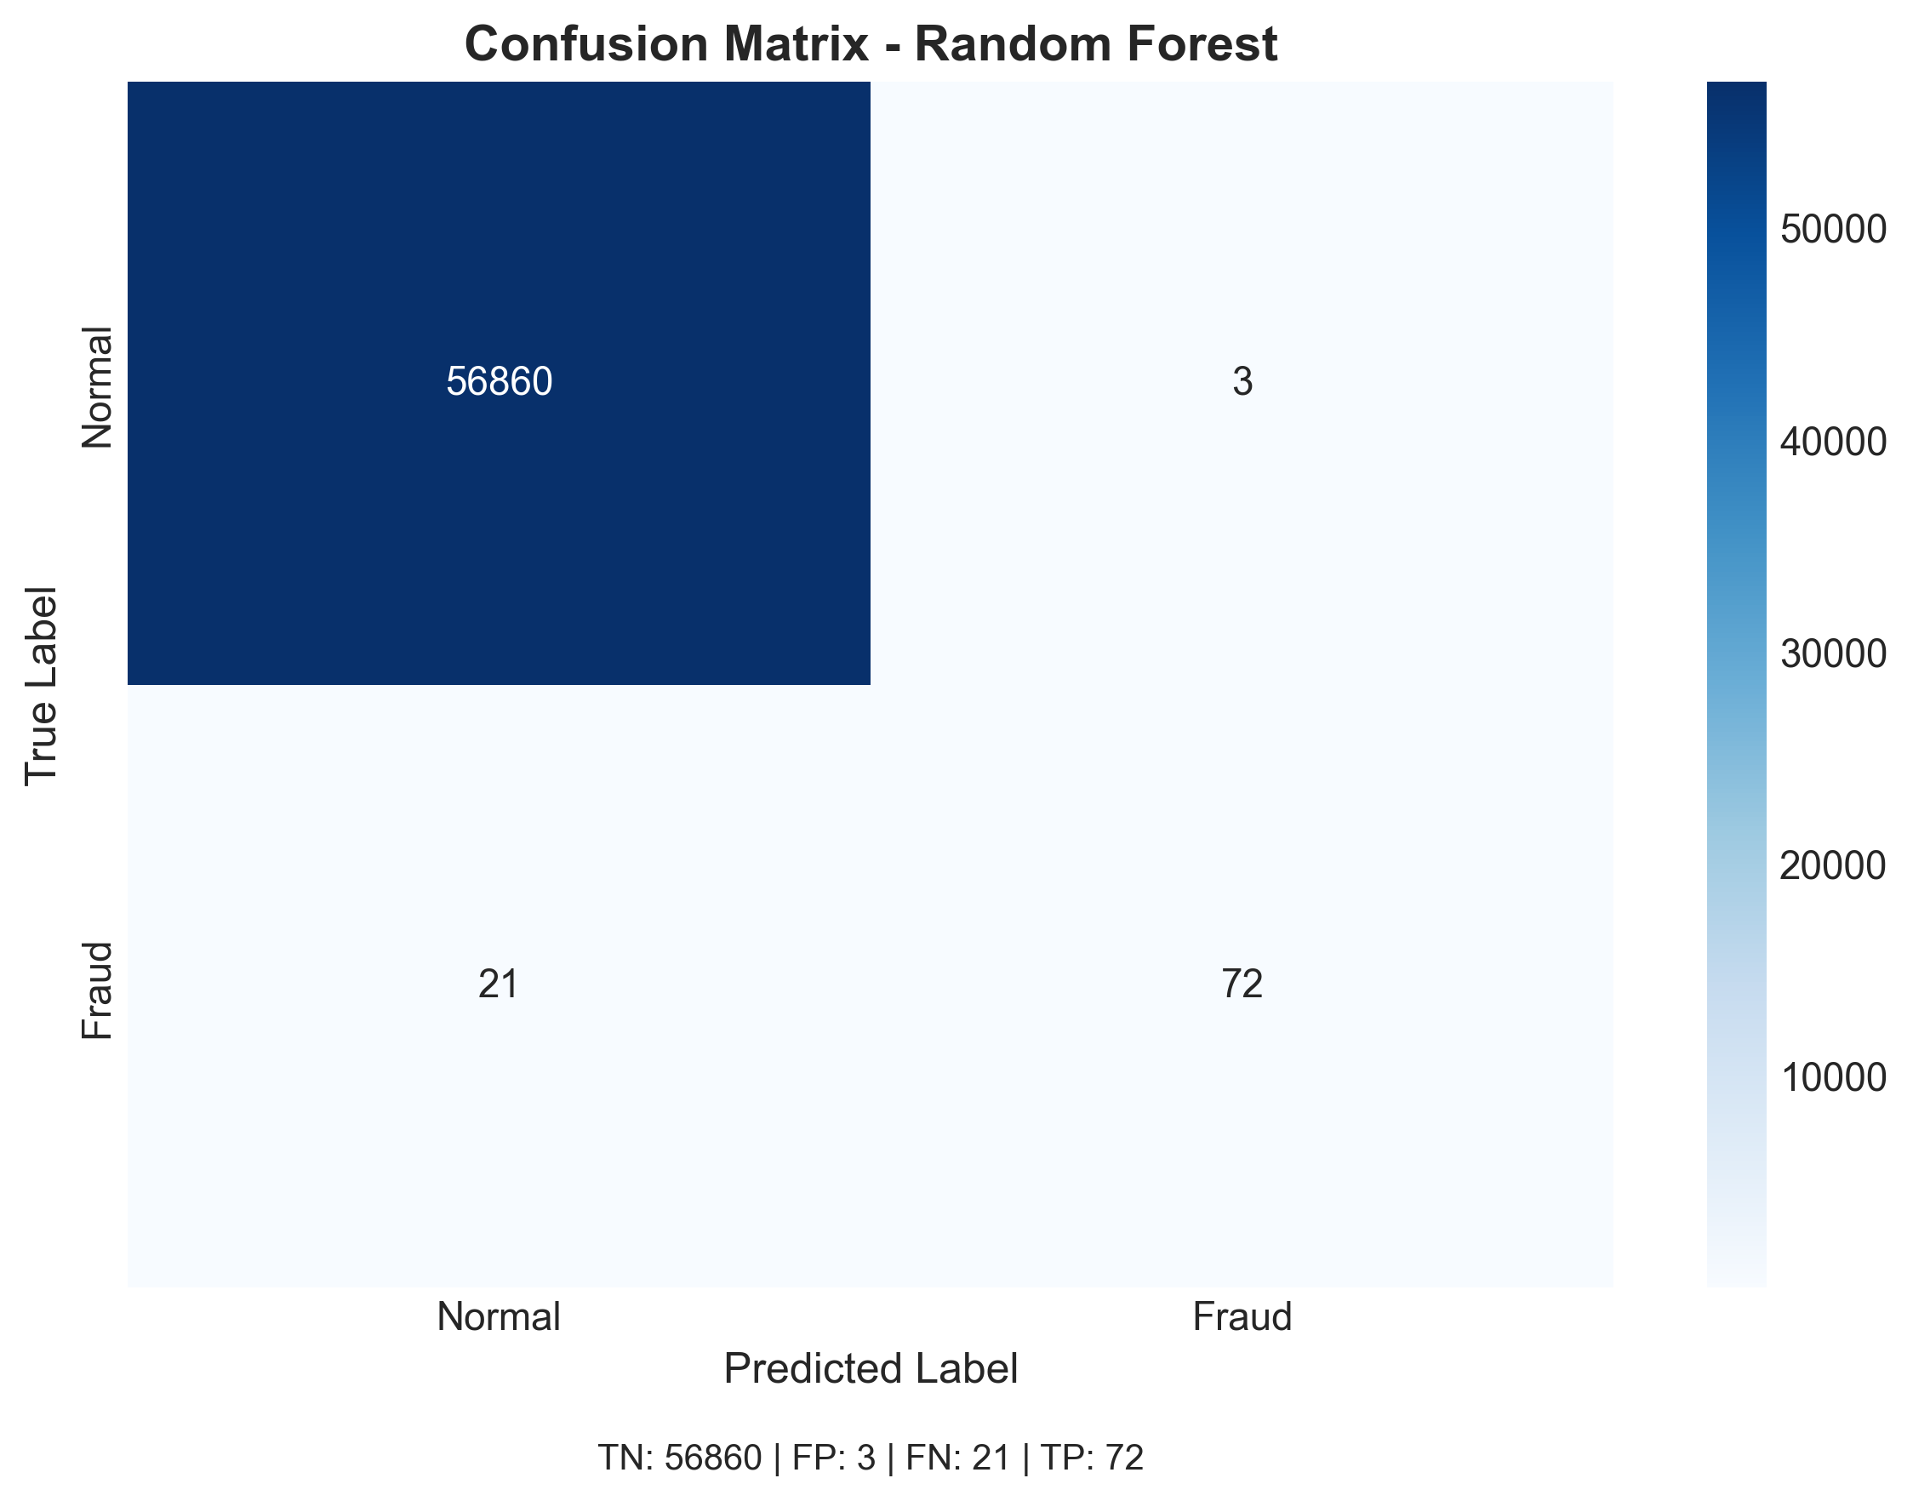
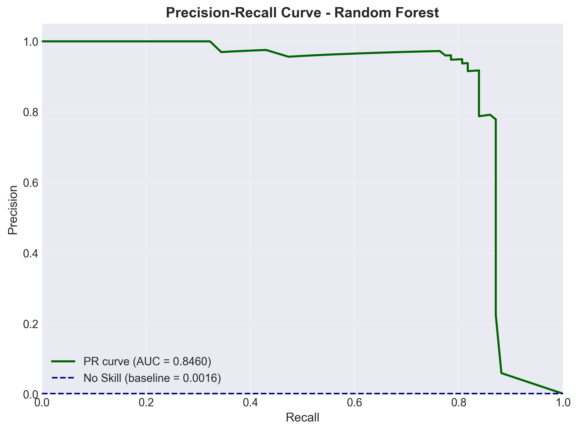
Random Forest Results (class_weights)
PR-AUC improved from 69% to 85%, confirming that ensemble tree-based models fundamentally outperform linear models for this problem.
Strong Precision (0.96) - Recall Balance (0.77)
PR-AUC = 0.846041
Also ,Precision jumped from 6%(lr’s value) to 96%. False positives dropped from just 1360 to 3. This is now operationally viable.
This result validated our direction — but we continued exploring whether gradient boosting methods could push performance even further.

Slide 20
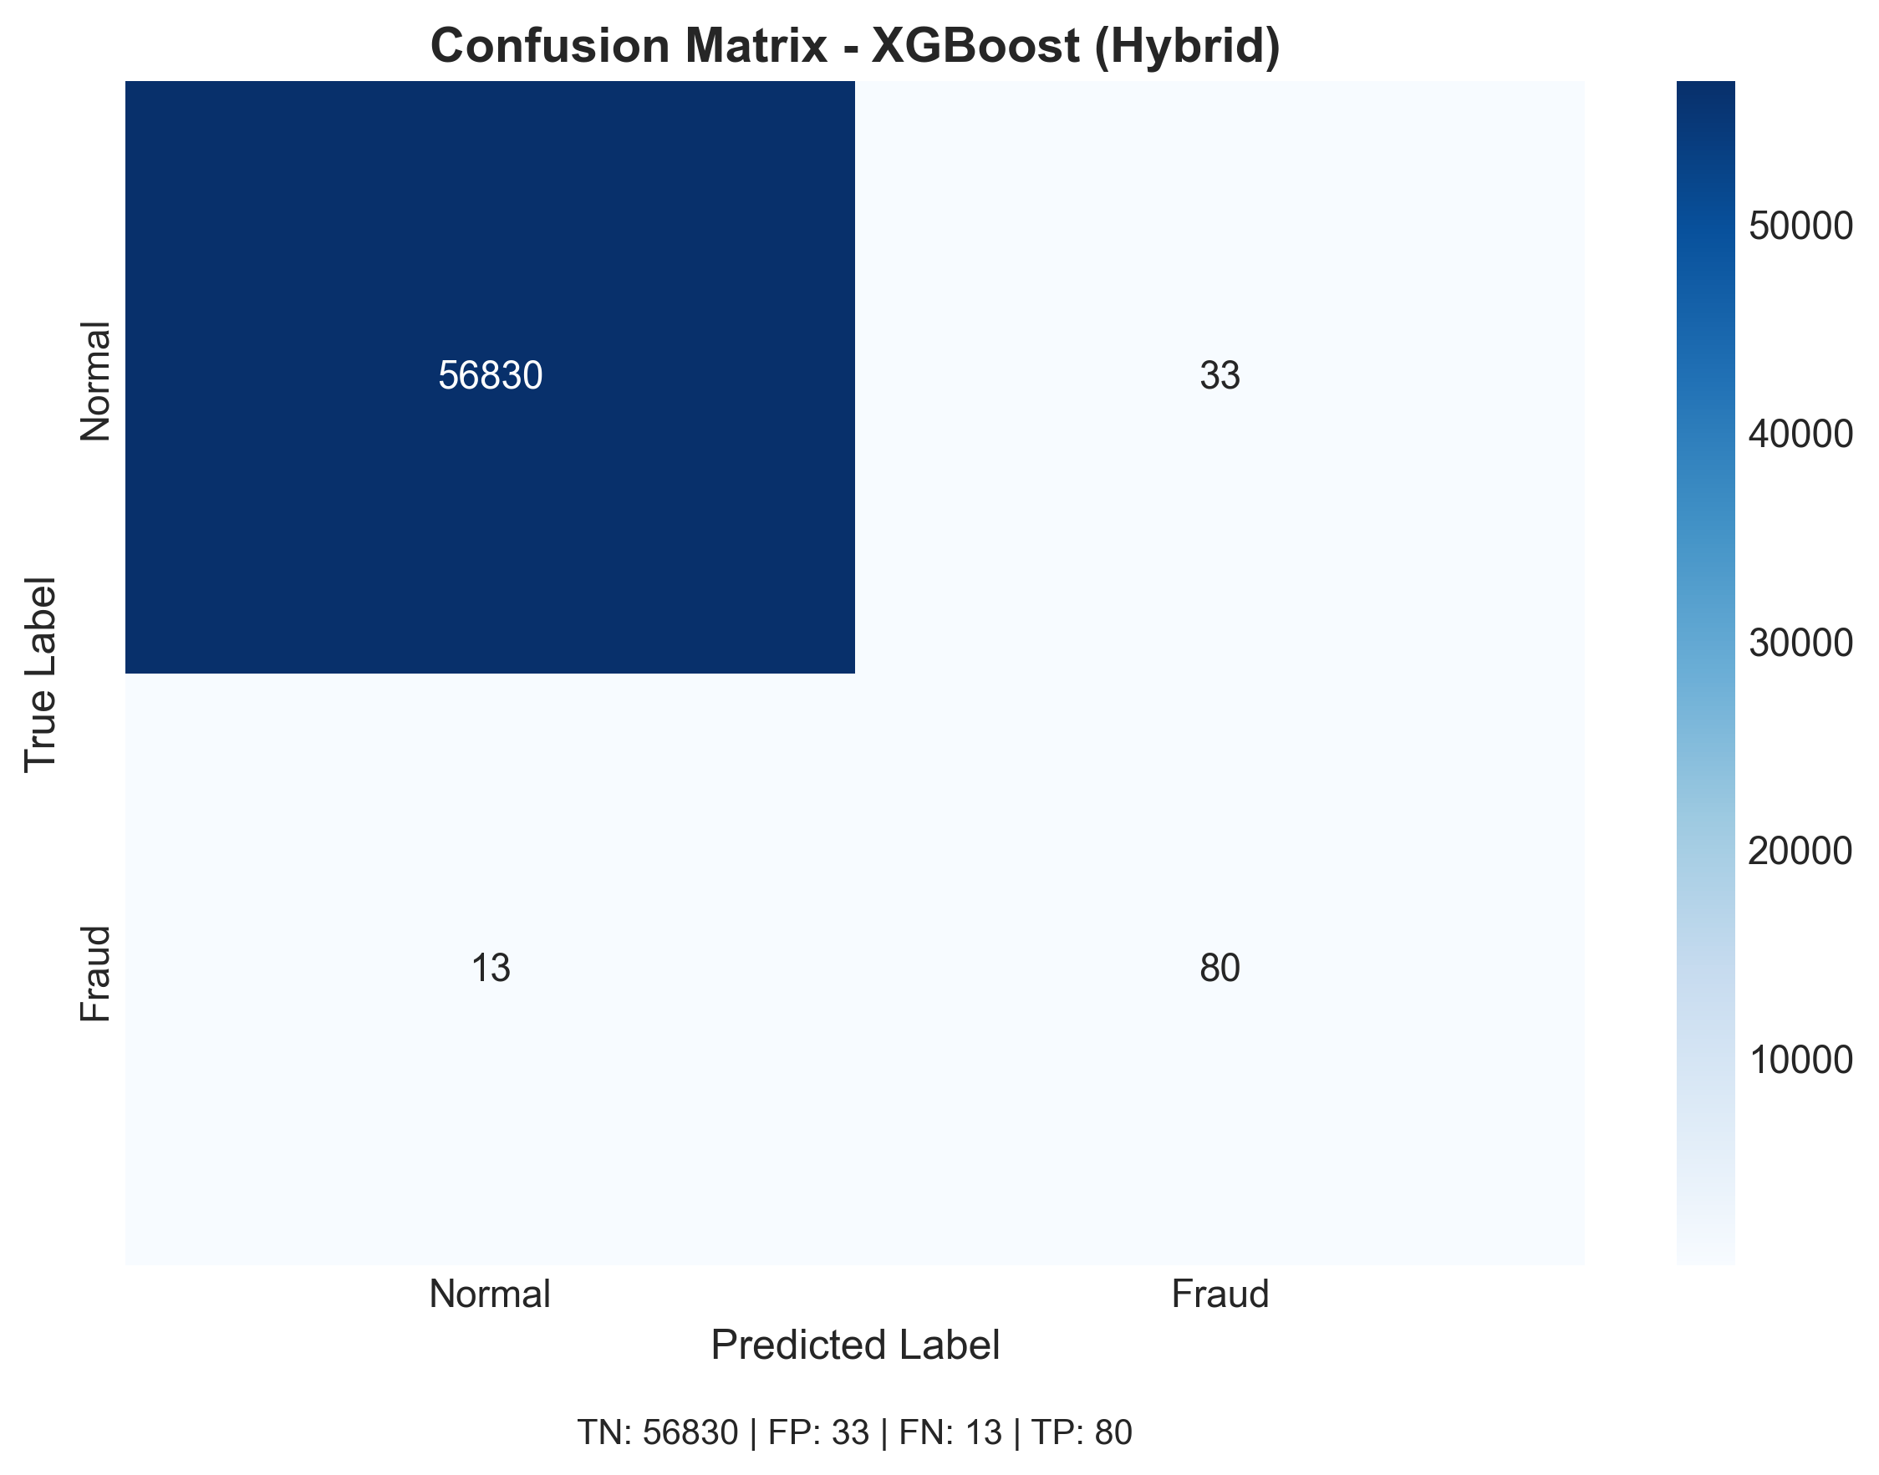
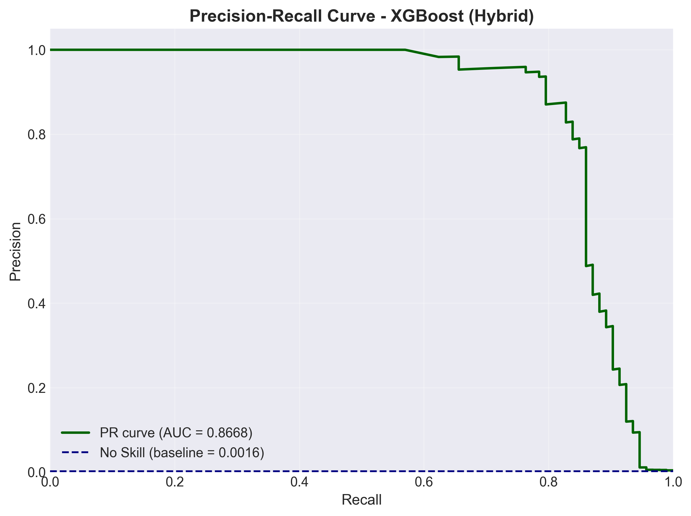
XGBoost Results
(scale_pos_weight)
In XGBoost, we used scale_pos_weight to directly address class imbalance and prioritize fraud detection. This increased recall by penalizing missed fraud cases more strongly. We then added the anomaly_score feature, which further improved overall detection quality by capturing abnormal transaction behavior.
PR-AUC ≈ 0.867
Precision = 0.70
Recall = 0.86
Metric | XGBoost Baseline | XGBoost Hybrid (scale_pos_weight + anomaly_score) | Impact
Precision | 92.5% | 70.8% | ↓ Trade-off due to aggressive fraud prioritization
Recall | 79.6% | 86.0% | ↑ +6.4pp more frauds detected
PR-AUC | 0.851 | 0.867 | ↑ +1.6% overall fraud detection quality

Slide 21
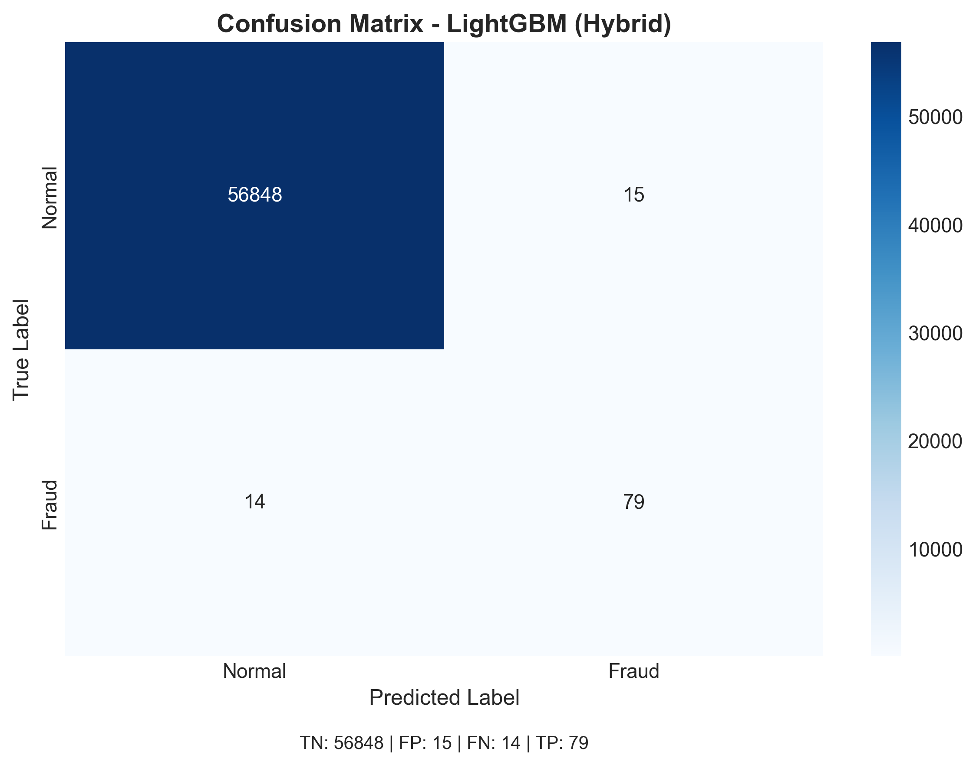
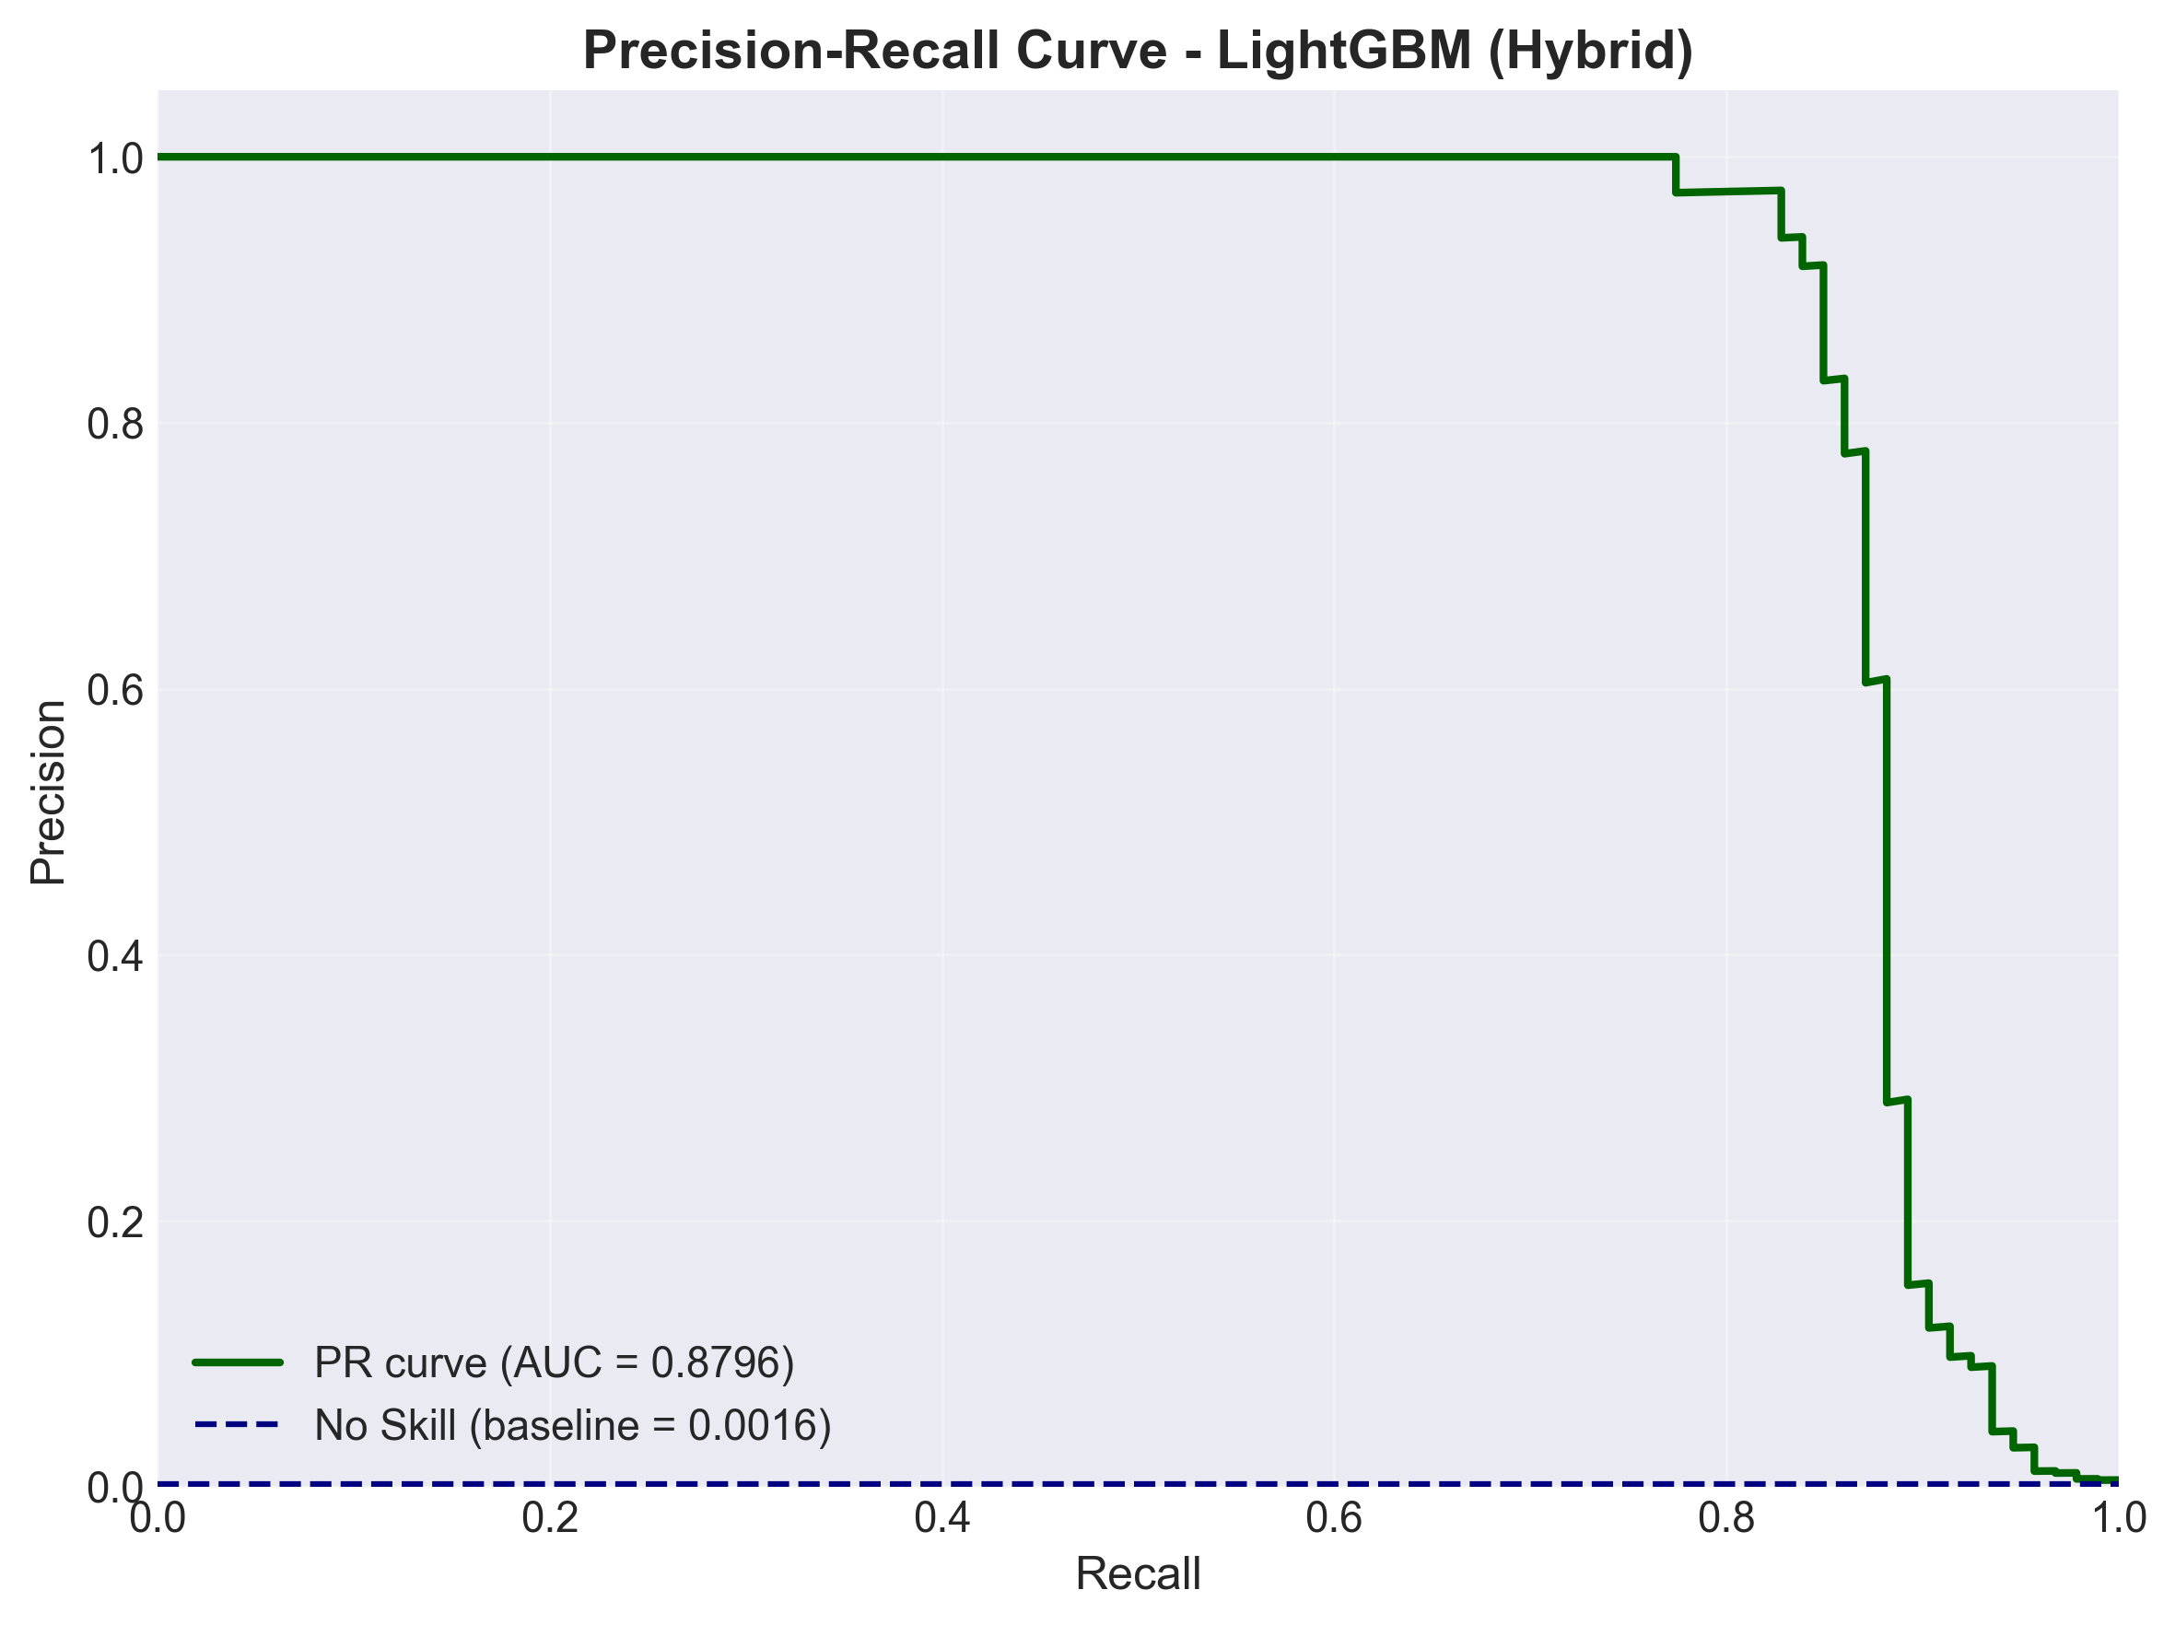
LightGBM Results : Best Baseline
(class_weights + anomaly_score)
Metric | Logistic Regression (Class Weights) | Random Forest (Class Weights) | XGBoost (ScalePosWeight) | LightGBM (Class Weights) 🏆
Precision | 0.0601 | 0.96 | 0.708 | 0.8404
Recall | 0.9355 | 0.7742 | 0.8602 | 0.8495
F1-Score | 0.1130 | 0.8571 | 0.7767 | 0.8449
PR-AUC | 0.6896 | 0.8460 | 0.8668 | 0.8796
PR-AUC (baseline): 0.8796
Fastest, most stable model
Precision (0.8404) – Recall (0.8494)

Slide 22

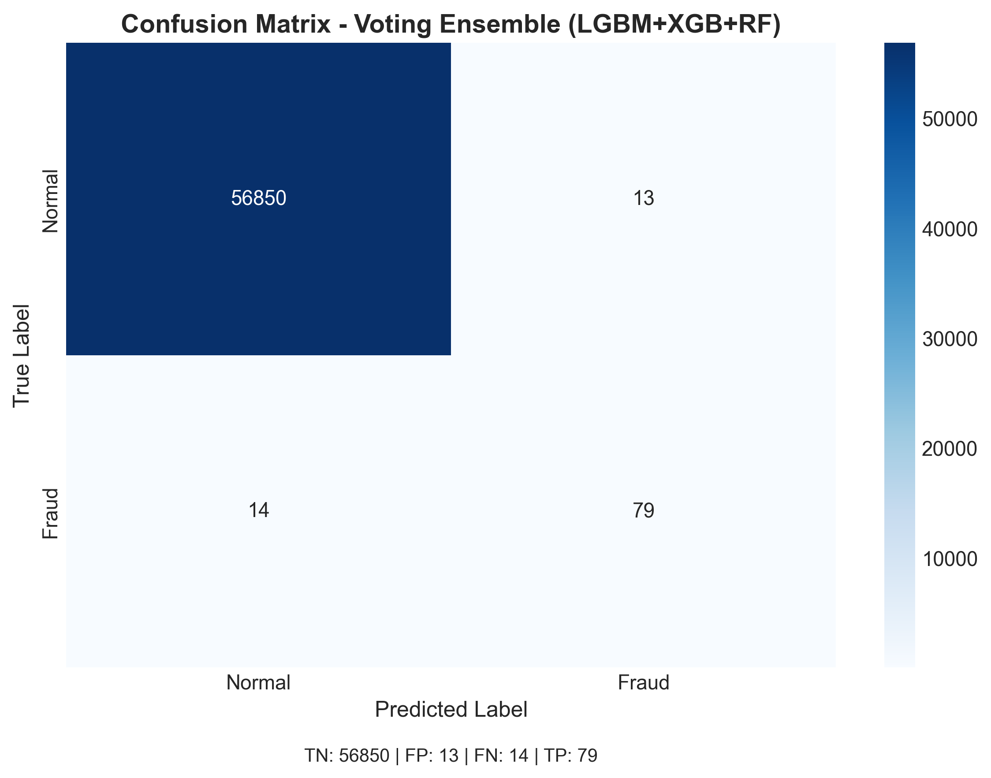
Voting_Ensemble_LGBM_XGB_RF Results
(LGBM=0.5 , XGB=0.3, RF = 0.2)
Feature | Voting Ensemble (RF+XGB+LGBM) | LGBM (Base Model) 🏆
Complexity | 🔴 High (3 Models) | 🟢 Low (1 Model)
PR-AUC (Potential) | 0.8724 | 0.8796 ↗
Precision (Default) | 85.87% | 84.04%
Maintenance | Hard to Maintain | Easy to Deploy
Decision We eliminated the Voting Ensemble because it added high complexity while giving only a small precision gain and a slight drop in PR-AUC compared to the best single model.
Further analysis showed that LightGBM achieved the highest PR-AUC and the best precision–recall balance, making it the most robust standalone model.
XGBoost showed strong recall-focused behavior, especially after adding the anomaly feature, but did not outperform LightGBM overall.
Therefore, we selected LightGBM and kept XGBoost only for calibration and threshold optimization, instead of using a more complex ensemble.
Key Rationale
Diminishing Returns: The Ensemble improved default Precision by only ~1.8% while increasing operational complexity.This represents a small performance gain for a large complexity cost.
PR-AUC Signal: The single LightGBM model achieved a higher PR-AUC (0.88) than the Ensemble (0.87). This indicates that the standalone model has stronger learning capacity, leaving more room for improvement through calibration and threshold optimization.

Slide 23
Undersampling Methods Fail
This dataset is already PCA-transformed.
Undersampling removes many normal samples and changes the PCA feature space.
This damages the data distribution and leads to lower PR-AUC.
Class weighting keeps all samples and gives much better performance.
Undersampling Methods
Class Weighting
BalancedBagging, EasyEnsemble
LightGBM, XGBoost
0.58 - 0.71
~0.88
PR-AUC
PR-AUC

Slide 24
04
Model Validation (Cross-Validation)

Slide 25
Cross-Validation Overview & Correction
Model | Precision (mean ± std) | Recall (mean ± std) | F1 (mean ± std) | PR-AUC (mean ± std) | ROC-AUC (mean ± std)
Logistic Regression (CW) | 0.0568 ± 0.0061 | 0.8979 ± 0.0277 | 0.1067 ± 0.0108 | 0.7170 ± 0.0209 | 0.9715 ± 0.0171
Random Forest (Baseline) | 0.9305 ± 0.0367 | 0.7554 ± 0.0487 | 0.8319 ± 0.0215 | 0.8257 ± 0.0165 | 0.9446 ± 0.0191
XGBoost (SPW + Anomaly Score) | 0.8875 ± 0.0360 | 0.7985 ± 0.0546 | 0.8383 ± 0.0157 | 0.8257 ± 0.0134 | 0.9758 ± 0.0134
LightGBM (CW + Anomaly Score) | 0.8854 ± 0.0256 | 0.7958 ± 0.0505 | 0.8367 ± 0.0210 | 0.8341 ± 0.0107 | 0.9713 ± 0.0116
CV Strategy
Key Correction
5-fold stratified CV reporting Precision, Recall, F1, PR-AUC, ROC-AUC.
5-fold stratified cross-validation is applied to all four model families using the cleaned dataset with the anomaly score feature, while intentionally keeping default probability thresholds and excluding calibration or cost-sensitive tuning to ensure a fair comparison of base model performance.
⚠ The reason of getting less PR-AUC value rather than the final value is because of the amount of data (%64 train, %16 test) we used for cross-validation which is less than the original one (%80 train, %20 test).

Slide 26
XGBOOST
HOLD-OUT vs CV COMPARSION TABLE
XGBoost (scale_pos_weight + anomaly_score)
Metric | Hold-out | CV Mean | CV Std
Precision | 0.7080 | 0.8875 | 0.0360
Recall | 0.8602 | 0.7985 | 0.0546
PR-AUC | 0.8668 | 0.8257 | 0.0134
ROC-AUC | 0.9837 | 0.9758 | 0.0134

Slide 27
LIGHTGBM
HOLD-OUT vs CV COMPARISON TABLE
LightGBM (Class Weights + Anomaly Score)
Metric | Hold-out | CV Mean | CV Std
Precision | 0.8404 | 0.8854 | 0.0256
Recall | 0.8495 | 0.7958 | 0.0505
PR-AUC | 0.8796 | 0.8341 | 0.0107
ROC-AUC | 0.9889 | 0.9713 | 0.0116

Slide 28
05
Enhancements

Slide 29
Probability Calibration Matters
Calibration improves the reliability of probability estimates, which is essential for risk-based decision systems.
Tree-based models often produce poorly calibrated probabilities
Isotonic Regression improves probability reliability
(better than Sigmoid for complex models)
Brier Score evaluates probability accuracy
Lower score → better calibration

Slide 30
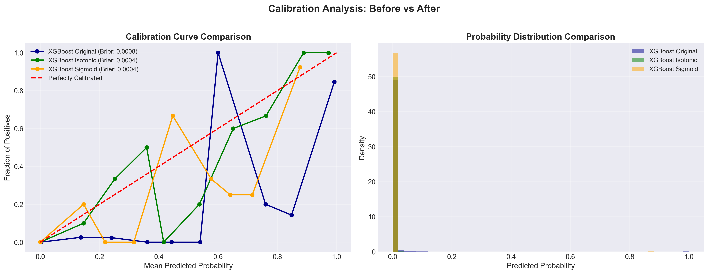
XGBoost Calibration Comparison
XGB_Calibrated_Isotonic
Precision: 0.9024
Recall: 0.7956
PR-AUC: 0.8787
XGB_Calibrated_Sigmoid
Precision: 0.8191
Recall: 0.8279
PR-AUC: 0.8790
Brier Score
Original: 0.0008
Isotonic: 0.0004
Sigmoid: 0.0004

Slide 31
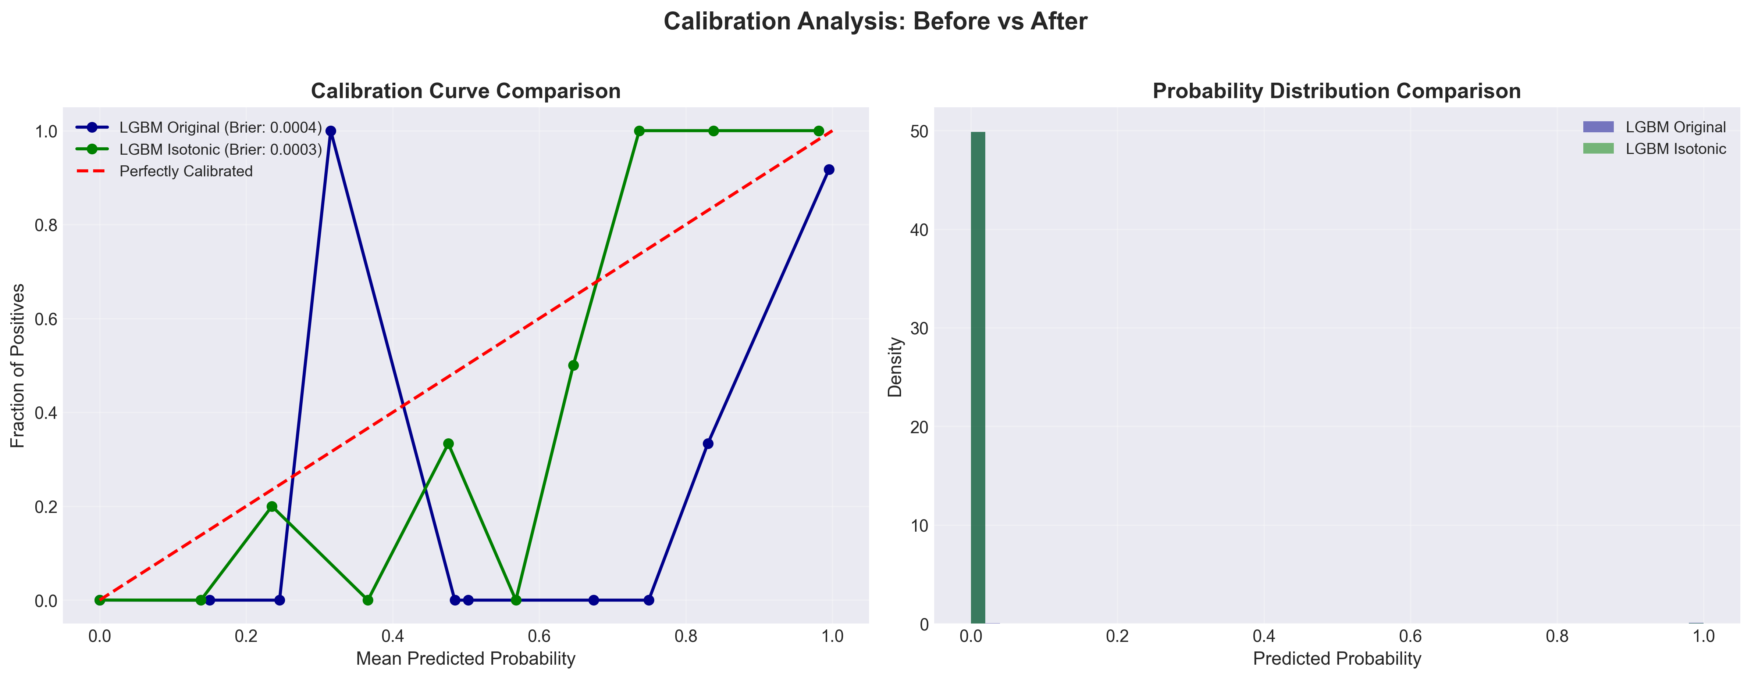
LightGBM Calibration Comparison
Metric | LGBM (Base / Class Weights) | LGBM (Calibrated – Isotonic)
Brier Score (Lower is Better) | 0.0004 | 0.0003 📉
Precision | 84.04% | 90.70% 🚀
Recall | 84.95% | 83.87%
PR-AUC | 87.96% | 88.07% ↗

Slide 32
06
Threshold Optimization

Slide 33
Why Threshold Optimization Matters
Fraud datasets are extremely imbalanced → default threshold = 0.50 is suboptimal.
Banks prioritize catching more fraud (FN cost ≫ FP cost).
Therefore threshold must be tuned using:
F2-score optimization (recall-focused) -> SELECTED ✓
Youden’s J (balanced statistical metric)
Cost-sensitive thresholds (business impact)

Slide 34
Cost-Sensitive Threshold Optimization (LightGBM)
Scenario (FN:FP) | Optimal Threshold | Min Cost | Default Cost | Cost Reduction (%) | Precision | Recall
50 : 1 | 0.23 | 664 | 758 | 12.40% | 0.8511 | 0.8602
100 : 1 | 0.23 | 1314 | 1508 | 12.86% | 0.8511 | 0.8602
200 : 1 | 0.23 | 2614 | 3008 | 13.10% | 0.8511 | 0.8602
500 : 1 | 0.23 | 6514 | 7508 | 13.24% | 0.8511 | 0.8602

Slide 35
Threshold Optimization (F2 & J) for LightGBM
Threshold Method | Threshold | F2-Score | Recall | Precision | FP (Test)
Default (sklearn) | 0.50 | 0.8515 | 83.9% | 90.7% | 8
F2-Optimized ✓ | 0.60 | 0.8609 | 83.9% | 96.3% | 3
Youden’s J ✗ | 0.0029 | 0.3494 | 93.5% | 10.0% | 786
Cost-Sensitive ✗ | 0.23 | 0.8584 | 86.0% | 85.1% | 14

Slide 36
Business Insight (Final Takeaway)
Selected deployment threshold: 0.60 (F2-optimized) — achieves the highest F2-score (0.8609) with 96.3% precision while keeping recall unchanged (83.9%).
Why F2 instead of cost-sensitive tuning? True FN/FP cost ratios are uncertain and organization-dependent; F2 provides a data-driven, recall-prioritizing objective without assuming a specific business cost.
Operational impact (hold-out test): only 3 false positives, resulting in a manageable alert volume and reduced analyst workload.
Alternative tested: cost-sensitive threshold (0.23) can reduce estimated cost (e.g., ~12–13% under FN:FP = 50–500:1 scenarios), but increases false positives to 14 (~4.6× more alerts than F2-optimized).
Practical alignment: F2 is widely used in highly imbalanced detection tasks when missing positives is more costly than false alarms, balancing recall (fraud capture) with precision (trust/alert quality).

Slide 37
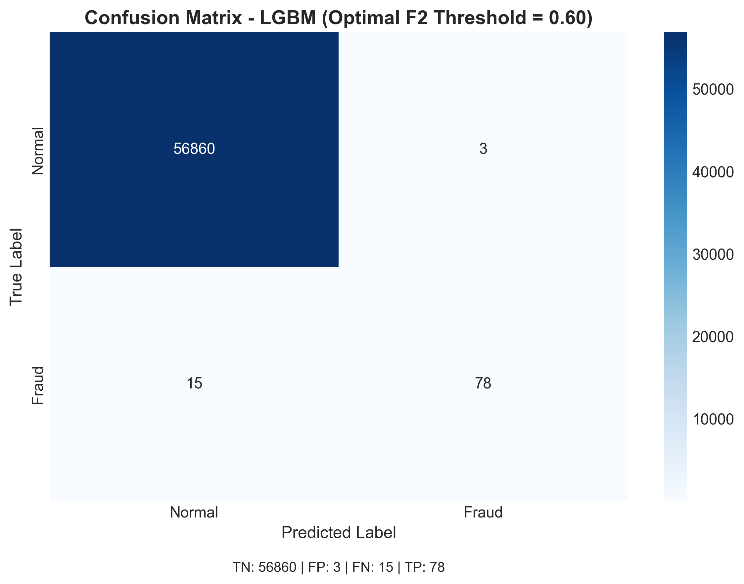
Optimized Confusion Matrix
(LightGBM)

Slide 38
07
Interpretability

Slide 39
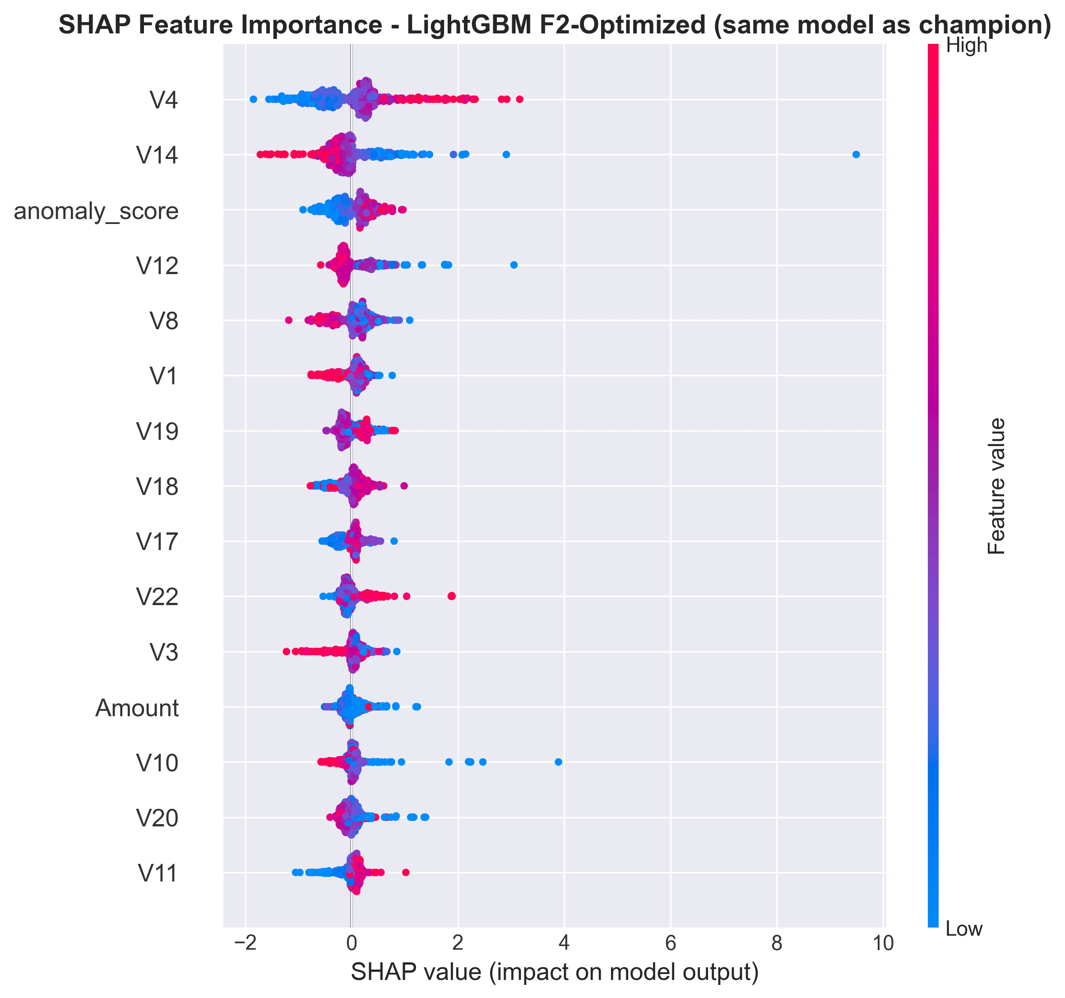
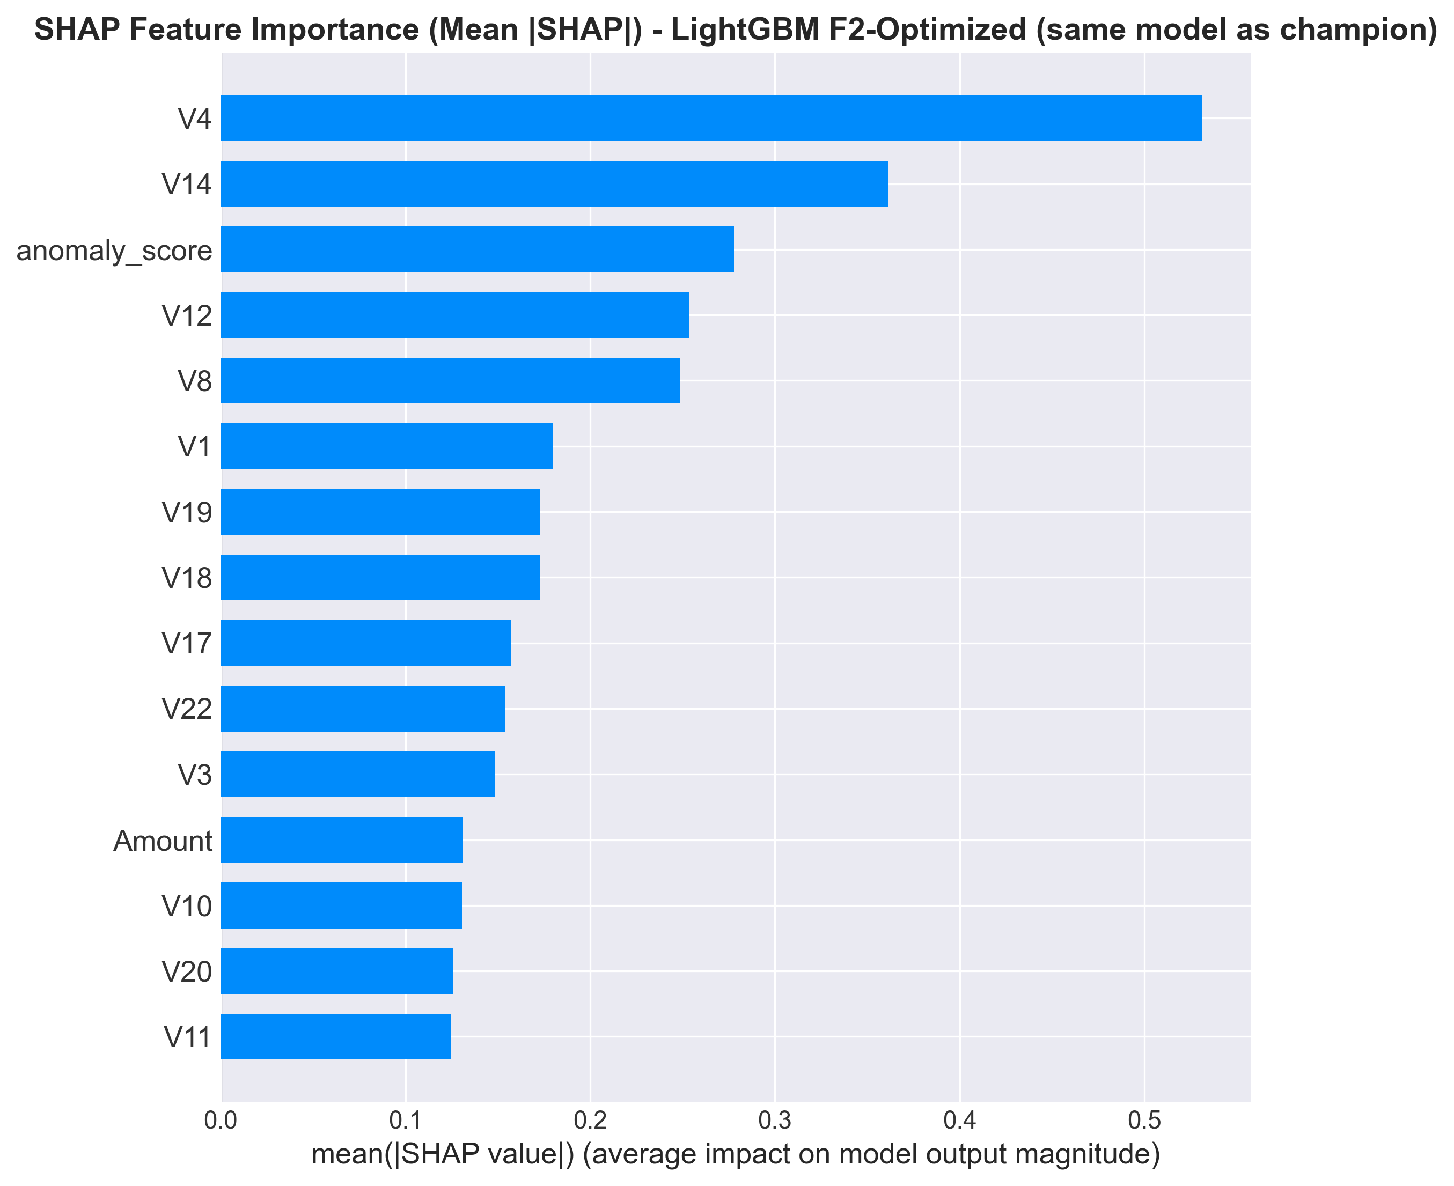
SHAP Global Interpretation
Across all transactions, SHAP reveals the top drivers of the model's predictions.
1. V4
2. V14
3. anomaly_score
4. V12
5. V8

Slide 40
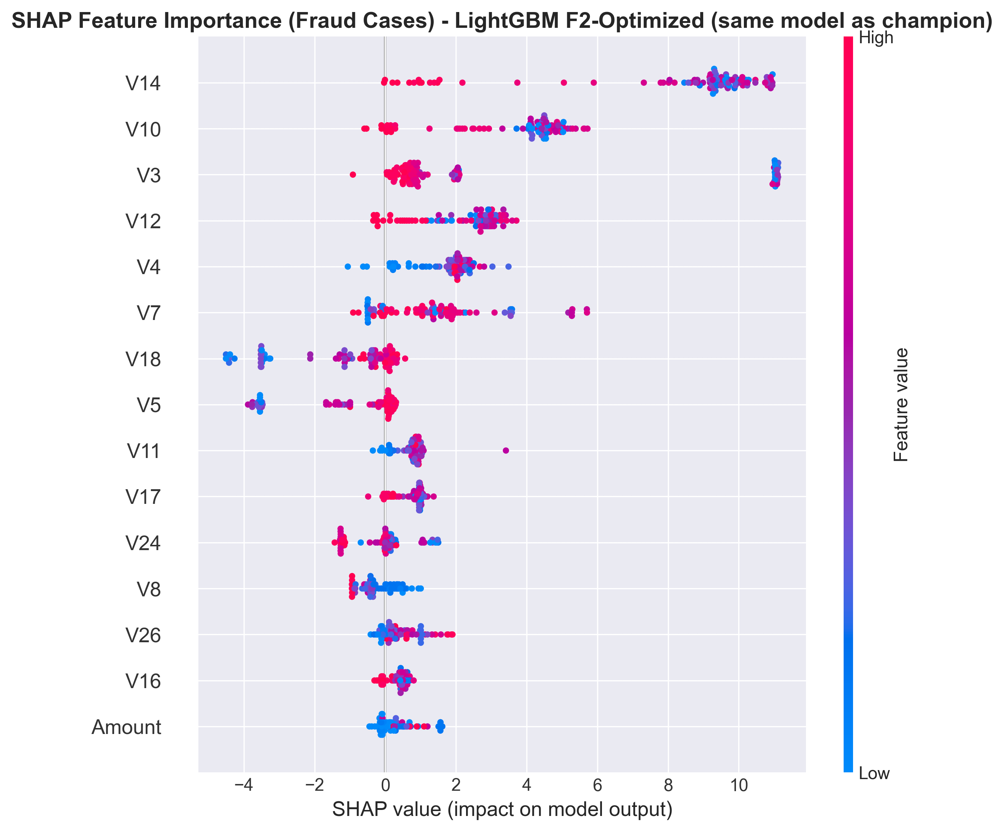
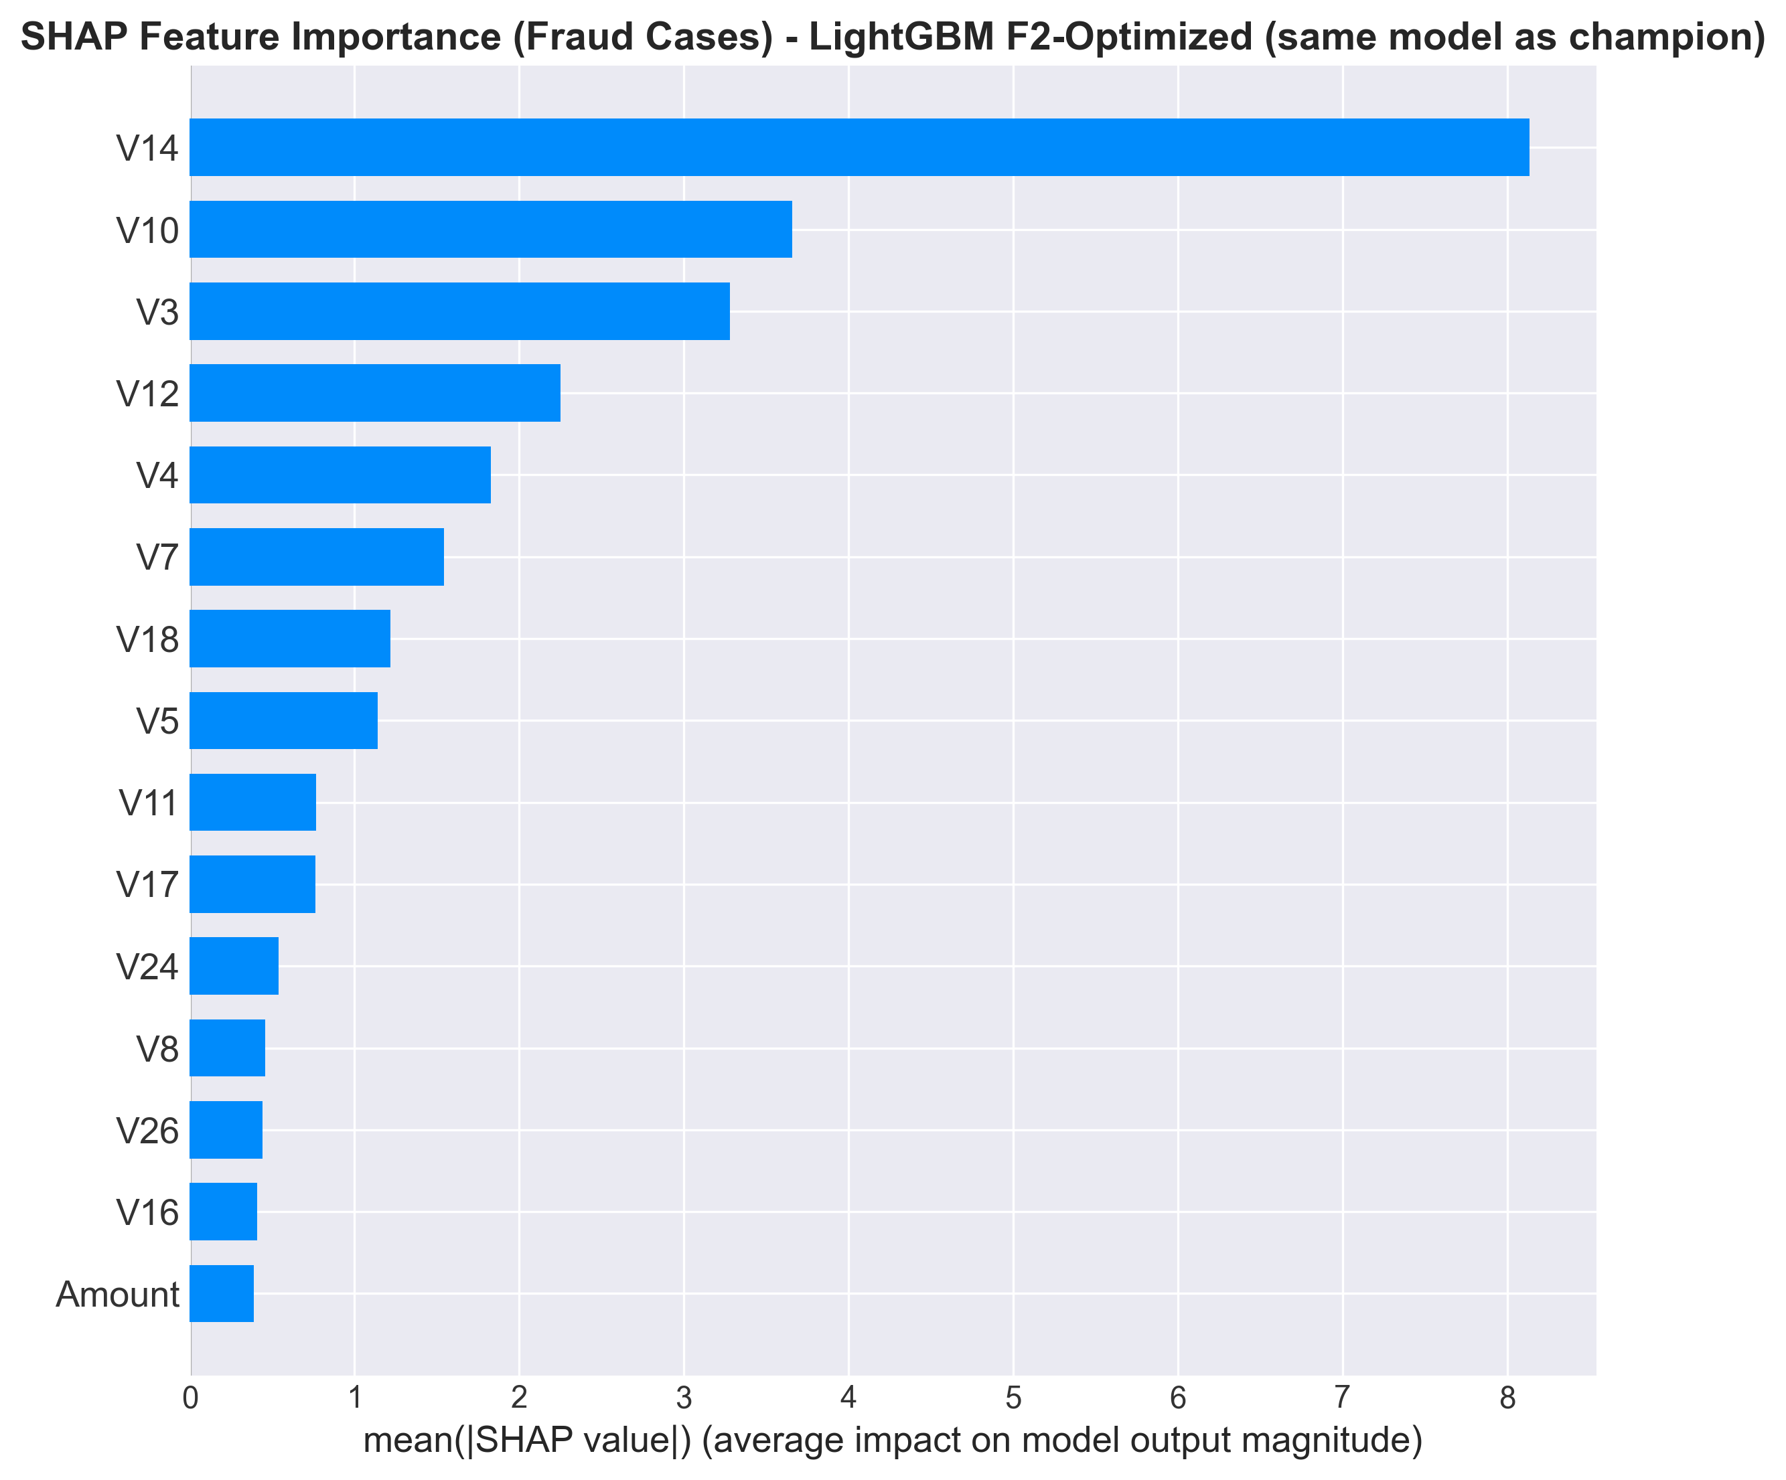
SHAP Fraud-Only Insights
When explaining only fraudulent cases, the patterns that distinguish fraud become clearer.
V14 dominates fraud-specific detections
Reveals distinct sub-patterns vs. global

Slide 41
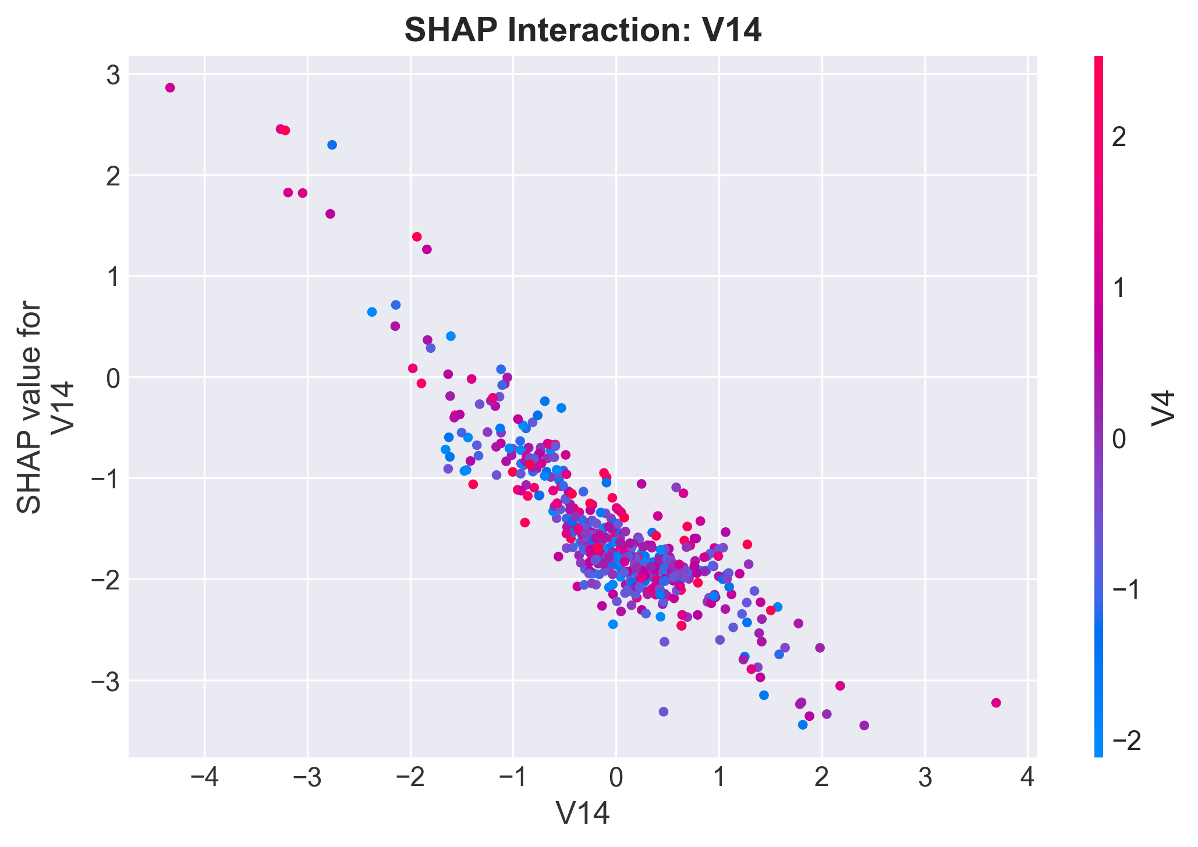
SHAP Interaction Effects
SHAP interaction values uncover how features work together to influence predictions.
Strong V14 × V4 interaction
Captures non-linear fraud relationships
This confirms tree ensembles outperform linear models.

Slide 42
08
Conclusion

Slide 43
Final Model Comparison
Model | PR-AUC | Recall | Precision
LGBM_Optimized_F2🏆 | 88.07% | 83.87% | 96.30%
LGBM_Calibrated_Isotonic | 88.07% | 83.87% | 90.69%
LGBM_ClassWeights | 87.96% | 84.94% | 84.04%
⚠️ These results show that LightGBM with F2-optimized threshold delivers the best overall trade-off between PR-AUC, recall, and precision, making it our final model.

Slide 44
Final Recommendation
F2-Optimized LightGBM
This model achieves the best trade-off between maximizing fraud recall and minimizing false positives, making it ideal for deployment.
PR-AUC: 0.8807
Precision: 0.9630
Recall: 0.8387

Slide 45
Project Limitations
Limited Interpretability
Potential Concept Drift
This dataset is PCA-anonymized for privacy. The 28 features are principal components, not real transaction attributes.
The dataset comes from 2013. Fraud patterns change over time, and many modern fraud types did not exist then.This limitation comes from the dataset, not from our modeling approach.
No Temporal Sequence Modeling
SHAP Computational Cost
SHAP is expensive and may need approximation for real-time use.
We used the time feature as a static input and treated each transaction independently. Because of this, we cannot detect behaviors like rapid repeated transactions or unrealistic location changes

Slide 46
Conclusion & Deliverables
We successfully built a complete, robust, and interpretable fraud detection system.
Evaluated 17+ models in 14 final comparisons.
Added anomaly detection, calibration, tuning, and SHAP.
Final model is robust, interpretable, and deployable.

Slide 47
Model | Precision | Recall | F1-Score | F2-Score | MCC | Cohen's Kappa | Balanced Accuracy | ROC-AUC | PR-AUC
LR_Baseline | 0.8169 | 0.6237 | 0.7073 | 0.6546 | 0.7134 | 0.7069 | 0.8117 | 0.9848 | 0.7213
LR_ClassWeights | 0.0601 | 0.9355 | 0.1130 | 0.2391 | 0.2339 | 0.1103 | 0.9558 | 0.9907 | 0.6896
RF_Baseline | 0.9367 | 0.7957 | 0.8605 | 0.8204 | 0.8631 | 0.8603 | 0.8978 | 0.9339 | 0.8488
RF_ClassWeights | 0.9600 | 0.7742 | 0.8571 | 0.8054 | 0.8619 | 0.8569 | 0.8871 | 0.9393 | 0.8460
XGB_Baseline | 0.9250 | 0.7957 | 0.8555 | 0.8186 | 0.8577 | 0.8553 | 0.8978 | 0.9801 | 0.8506
XGB_ScalePosWeight | 0.7080 | 0.8602 | 0.7767 | 0.8247 | 0.7800 | 0.7763 | 0.9298 | 0.9837 | 0.8668
LGBM_ClassWeights | 0.8404 | 0.8495 | 0.8449 | 0.8476 | 0.8447 | 0.8447 | 0.9246 | 0.9889 | 0.8796
BalancedBagging_Hybrid | 0.0820 | 0.8925 | 0.1502 | 0.2999 | 0.2678 | 0.1477 | 0.9381 | 0.9759 | 0.5846
EasyEnsemble | 0.0389 | 0.9462 | 0.0747 | 0.1669 | 0.1876 | 0.0718 | 0.9540 | 0.9921 | 0.7115
Voting_LGBM_XGB_RF | 0.8587 | 0.8495 | 0.8541 | 0.8513 | 0.8538 | 0.8538 | 0.9246 | 0.9896 | 0.8724
XGB_Calibrated_Isotonic | 0.9024 | 0.7957 | 0.8457 | 0.8150 | 0.8472 | 0.8455 | 0.8978 | 0.9855 | 0.8788
XGB_Calibrated_Sigmoid | 0.8191 | 0.8280 | 0.8235 | 0.8262 | 0.8233 | 0.8232 | 0.9138 | 0.9817 | 0.8791
RF_Calibrated_Isotonic | 0.9359 | 0.7849 | 0.8538 | 0.8111 | 0.8569 | 0.8536 | 0.8924 | 0.9588 | 0.8495
LGBM_Calibrated_Isotonic | 0.9070 | 0.8387 | 0.8715 | 0.8515 | 0.8720 | 0.8713 | 0.9193 | 0.9888 | 0.8807
XGB_Optimized | 0.7692 | 0.8602 | 0.8122 | 0.8403 | 0.8131 | 0.8119 | 0.9299 | 0.9837 | 0.8668
RF_Optimized | 0.7788 | 0.8710 | 0.8223 | 0.8508 | 0.8233 | 0.8220 | 0.9353 | 0.9339 | 0.8488
LGBM_Optimized_F2 | 0.9630 | 0.8387 | 0.8966 | 0.8609 | 0.8985 | 0.8964 | 0.9193 | 0.9888 | 0.8807

Slide 48


Simulated Transaction Scenarios
Predict Fraud Risk
To better understand the model’s decision-making process, we simulate several transaction scenarios and analyze the predicted fraud probabilities.

Slide 49



THANK YOU

